Slide 1
My Love
——不定冠词的用法
指导老师：郑彩妍、刘晓斌
设计制作：
华南师范大学外文学院 邹珈玲
广东省东莞市东莞中学初中部 郑彩妍

Slide 2
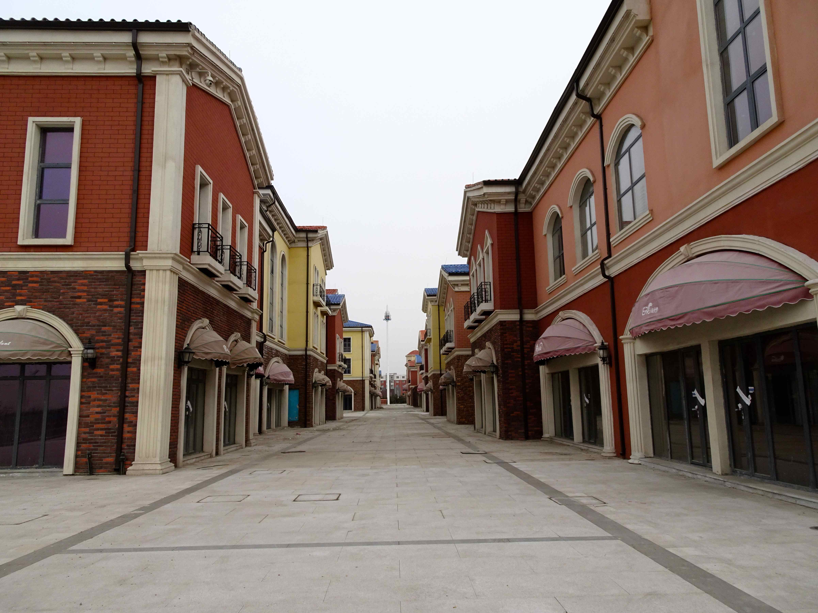
An empty street
An empty house
A hole inside my heart

Slide 3
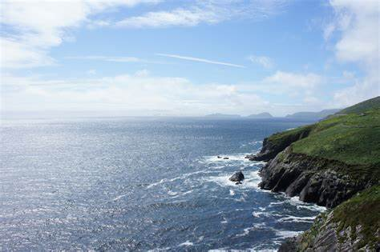
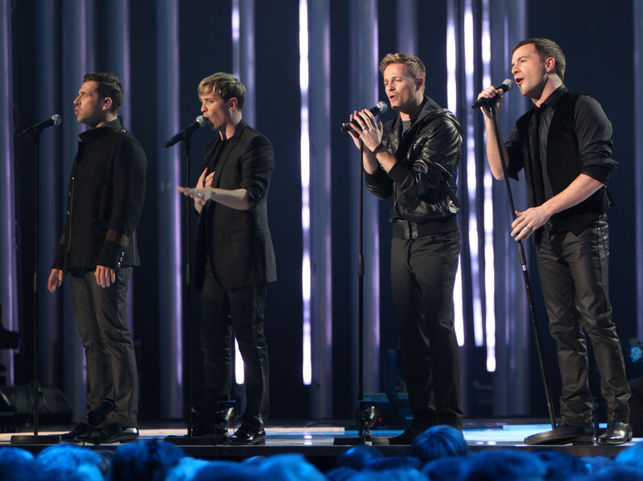
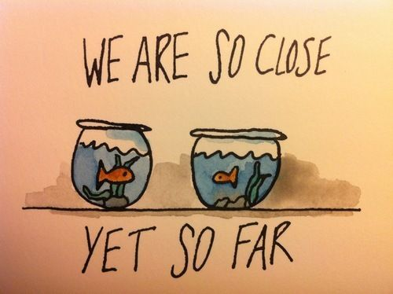
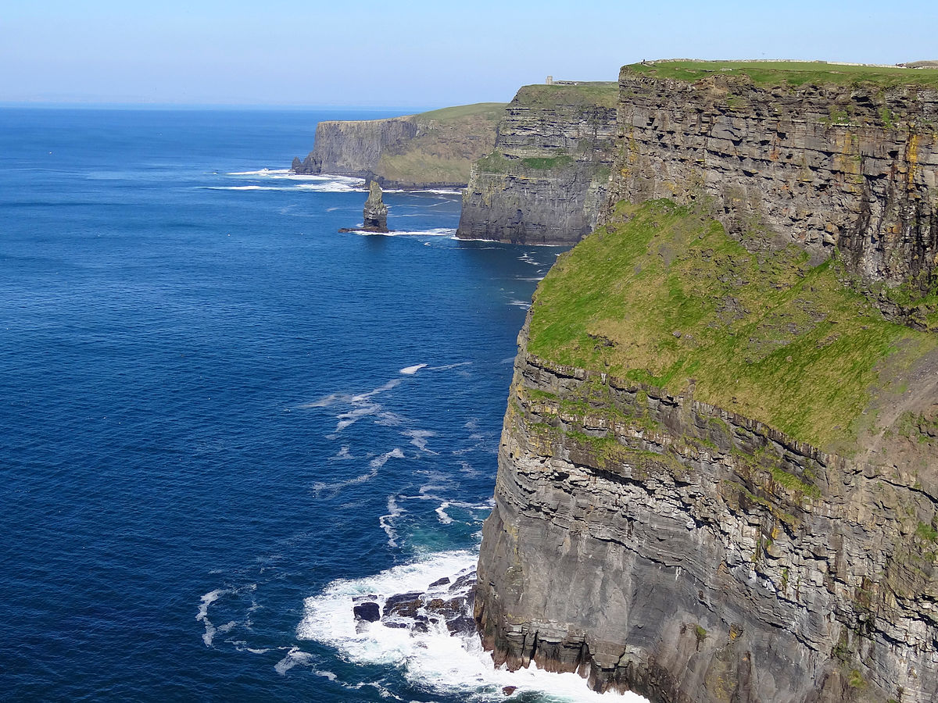
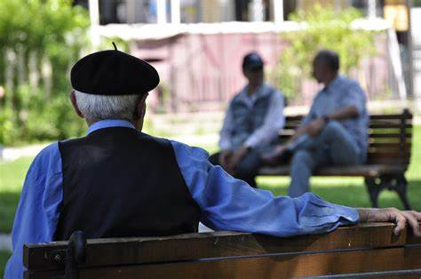
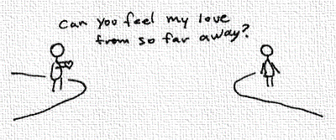
But I can't stop to
keep myself from thinking
Oh no
And oh my love
I'm holding on forever
So I say a little prayer
And hope my dreams will take me there
Say a little prayer
Dreams will take me there
I wonder how
I wonder why
I wonder where they are
I wonder how
I wonder why
And oh my love
I'm holding on forever
Where the fields are green
to see you once again
My love
Where the fields are green
to see you once again
Over seas and coast to coast
To find a place I love the most
Over seas and coast to coast
To find a place I love the most
Where the skies are blue
to see you once again, my love
Over seas and coast to coast
To find a place I love the most
The days we had
The songs we sang together Oh yeah
To hold you in my arms
To promise you my love
I’m all alone
The rooms are getting smaller
Over seas and coast to coast
To find a place I love the most
Where the skies are blue
to see you once again
Where the skies are blue
to see you once again, my love
Where the skies are blue
to see you once again, my love
To tell you from the heart
You're all I'm thinking of
The days we had
The songs we sang together
Reaching for a love that seems so far
Where the fields are green
to see you once again, my love
Where the fields are green
to see you once again, my love
So I say a little prayer
And hope my dreams will take me there
I try to read
I go to work
Reaching for a love that seems so far
So I say a little prayer
And hope my dreams will take me there
I wonder where they are
I'm laughing with my friends
Reaching for a love that seems so far

Slide 4
Thank you for listening

