Slide 1
Teenage Summer Days
——专有名词
设计制作：华南师范大学外文学院 李素婷
广东省东莞市东莞中学初中部 毛婷婷
指导老师： 毛婷婷、刘晓斌

Slide 2
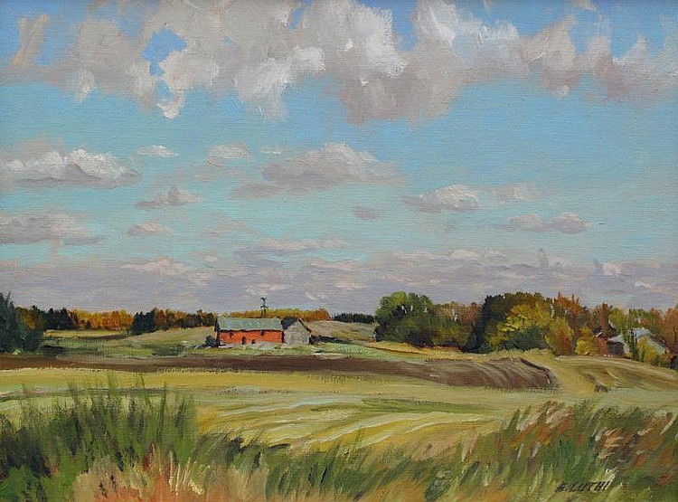
Down on Pico and Fedora

Slide 3
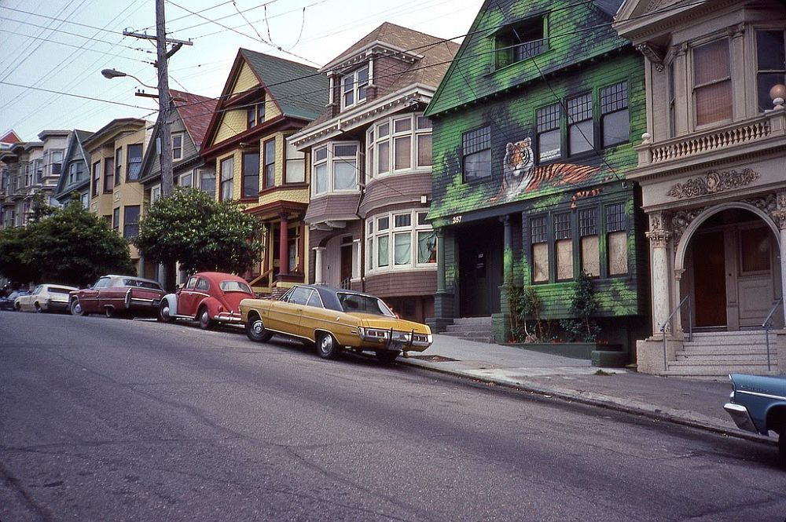
Back in 1983

Slide 4
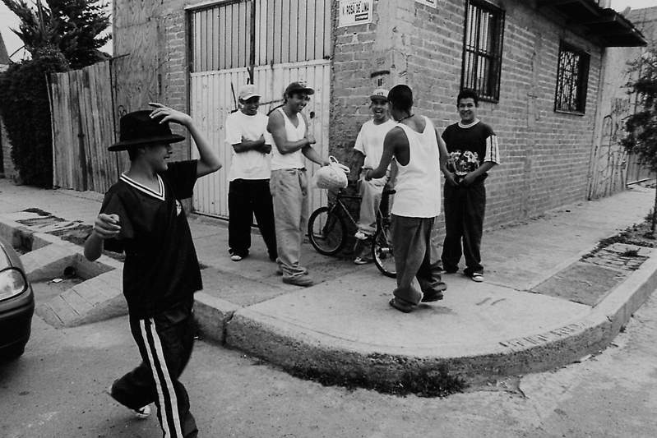
All the cholos on the corner

Slide 5
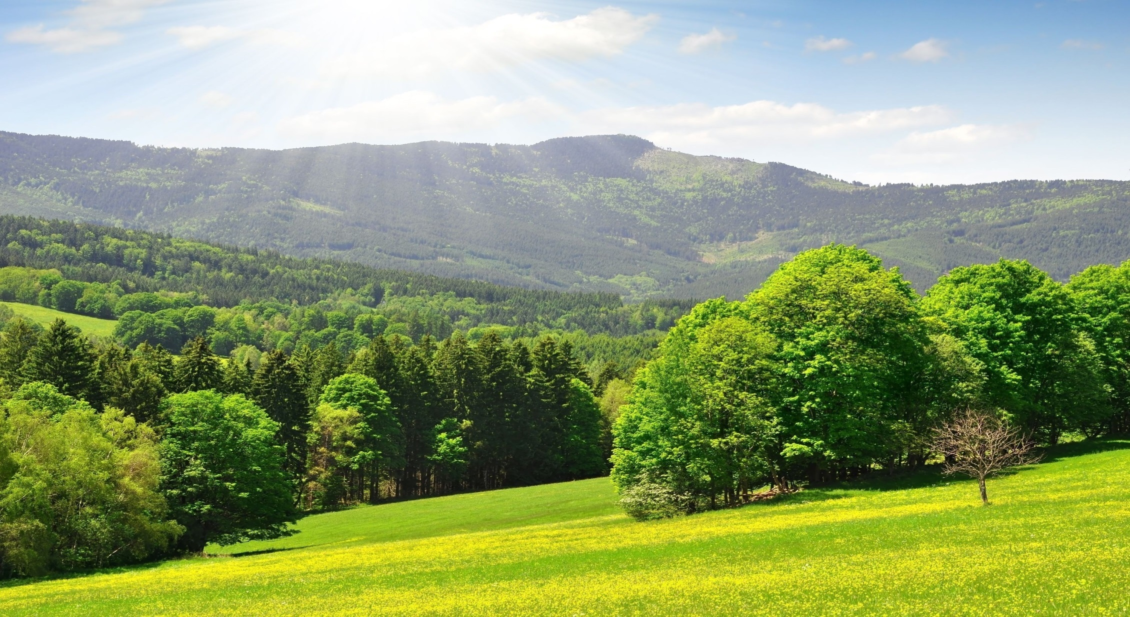
Hid their pistols in the trees

Slide 6
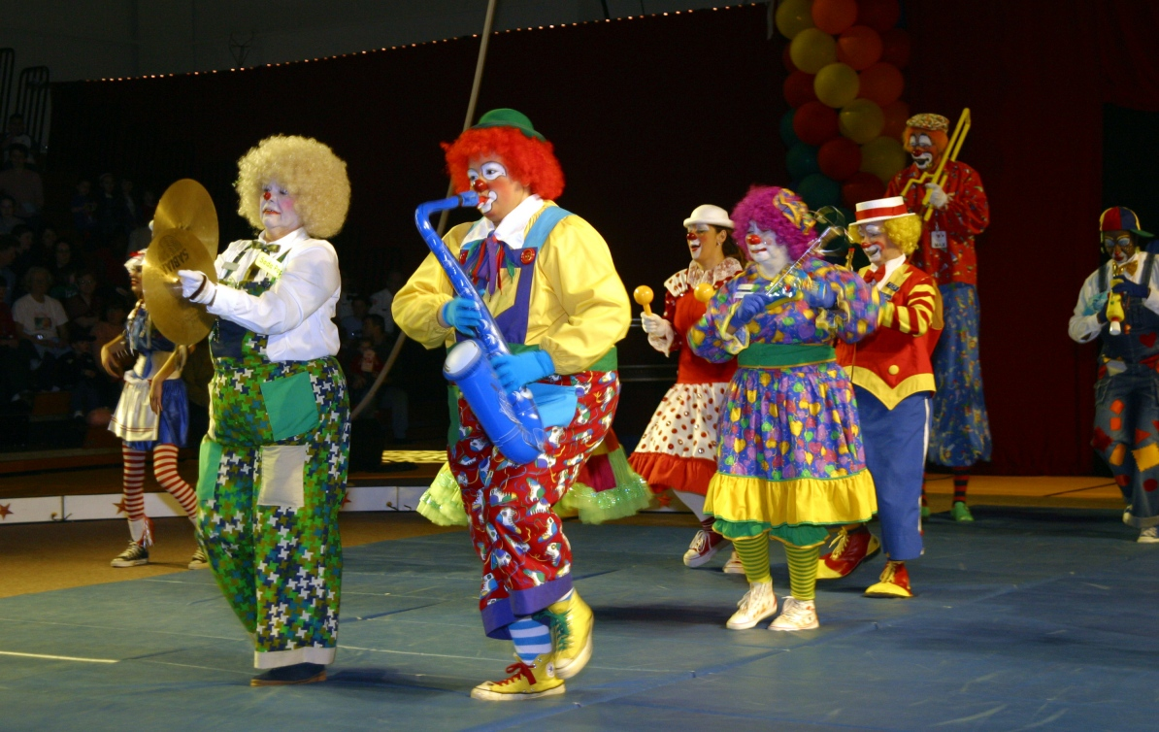
El Funny Clown lived off of Sunset

Slide 7
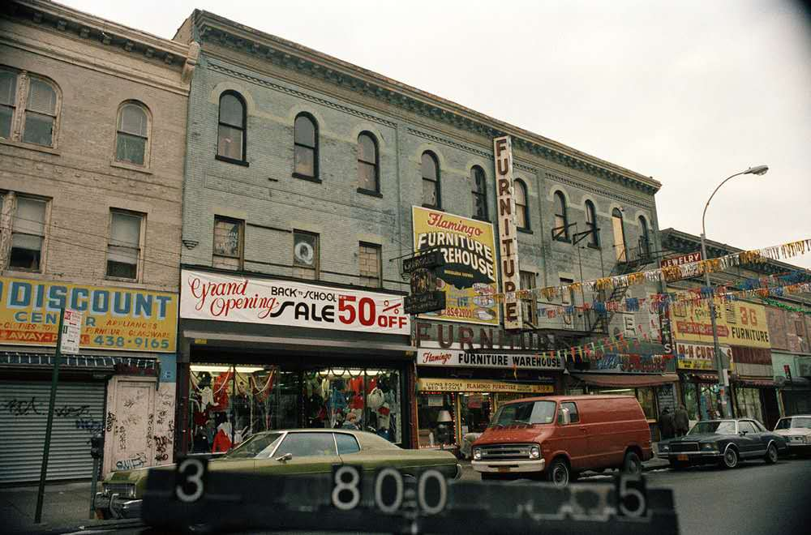
On a street called Benton Way

Slide 8
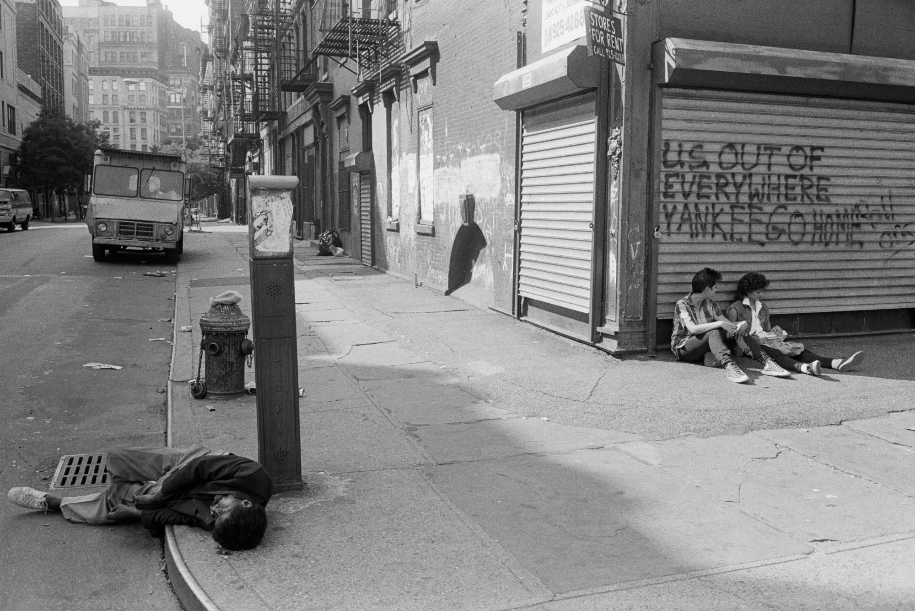
There were blood satins on the sidewalk

Slide 9
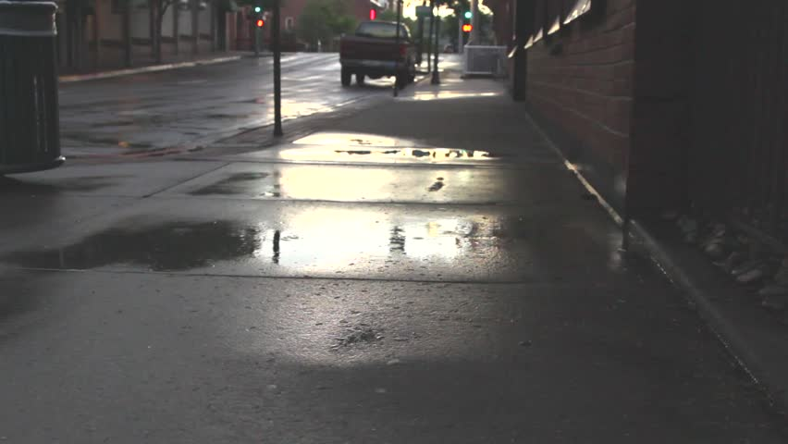
But the rain washed them away

Slide 10
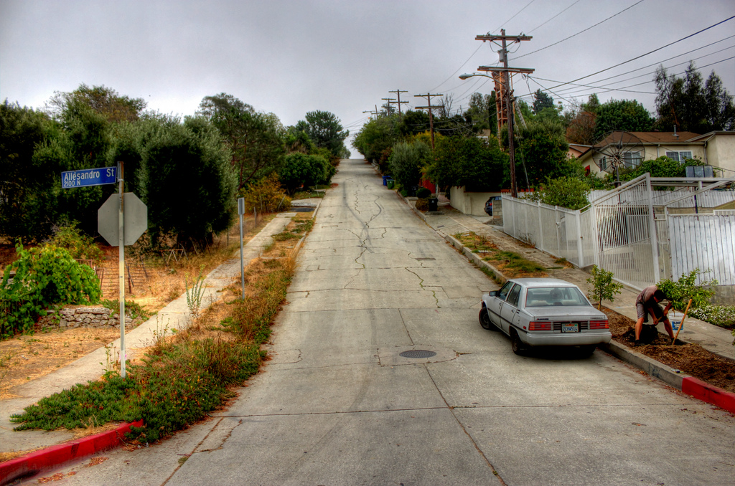
On the mean streets of L.A.

Slide 11
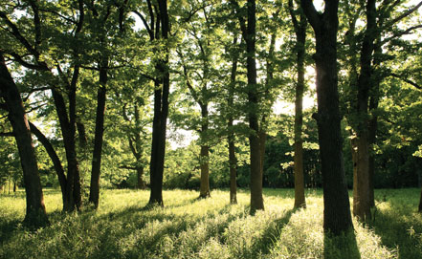
All those teenage summer days

Slide 12
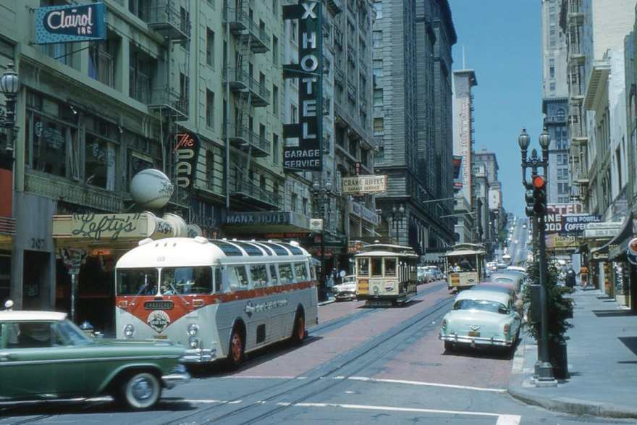
On the mean streets of L.A.
On the mean streets of L.A.

Slide 13
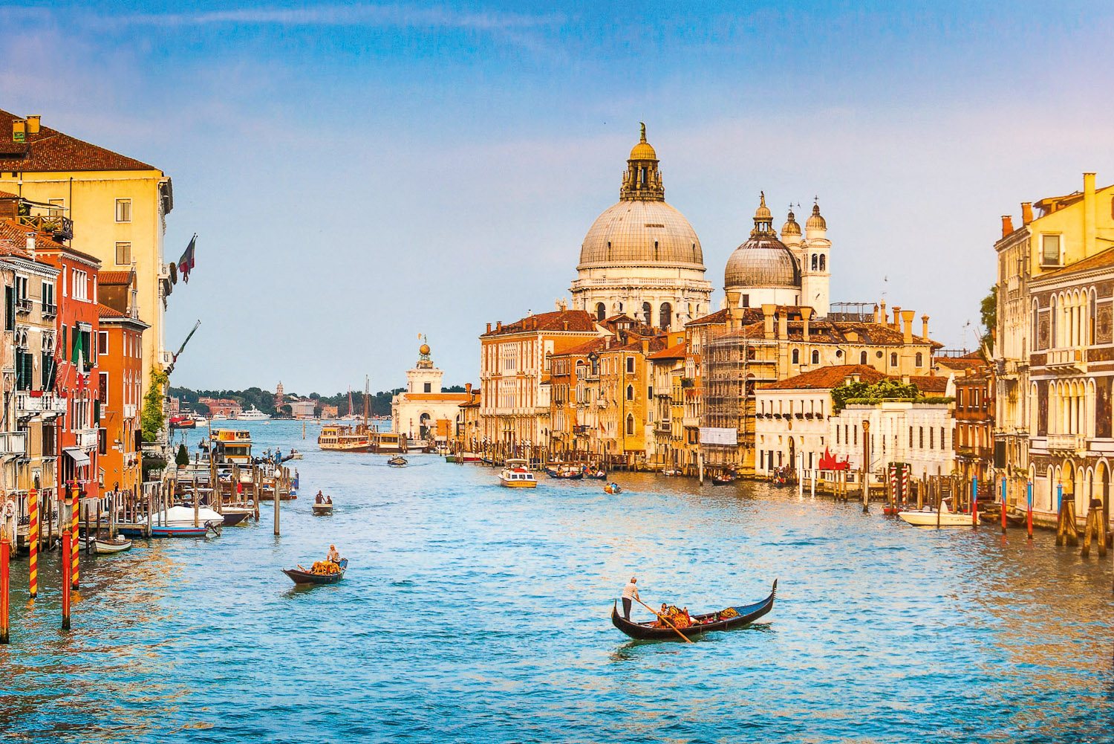
We took the bus way down to Venice

Slide 14
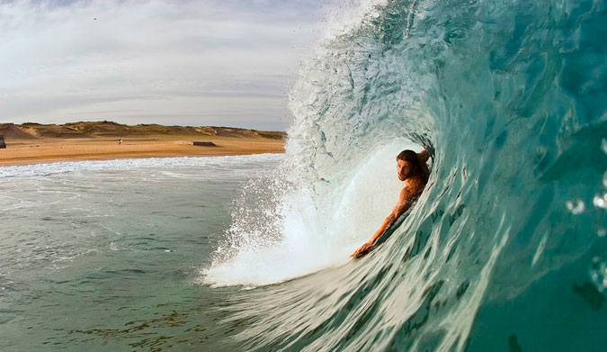
Went bodysurfing in the waves

Slide 15
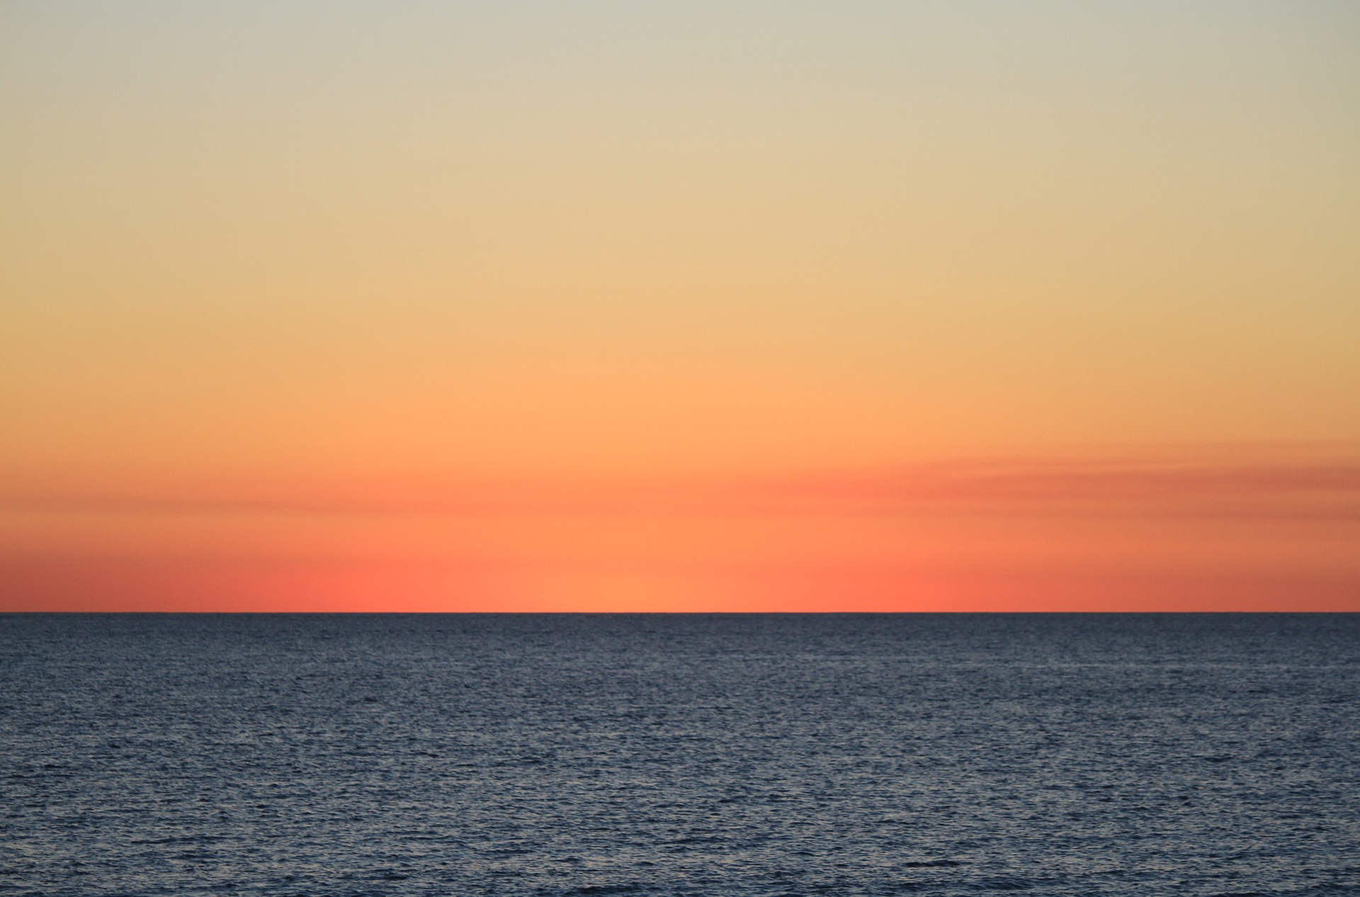
Staring out at the horizon

Slide 16
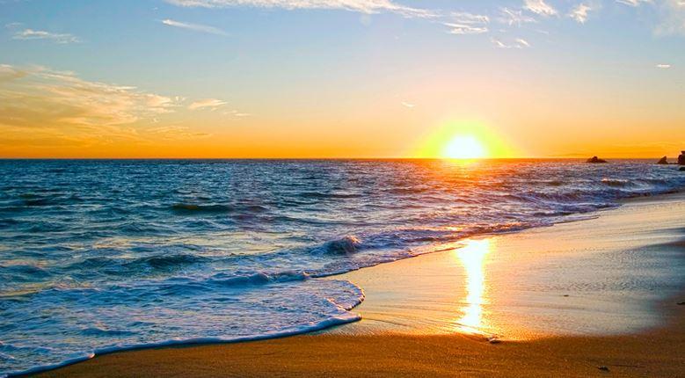
On those teenage summer days

Slide 17
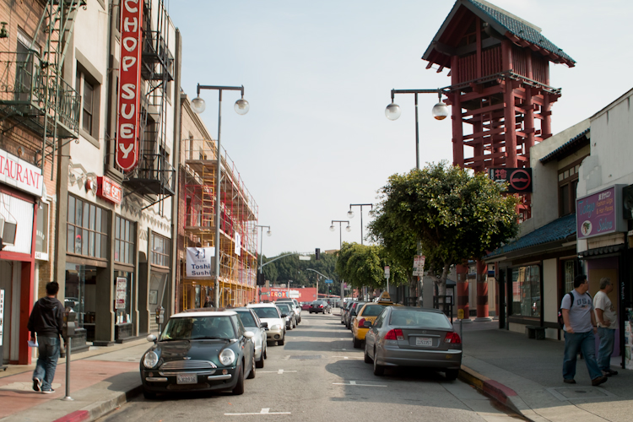
On the mean streets of L.A.
On the mean streets of L.A.

Slide 18
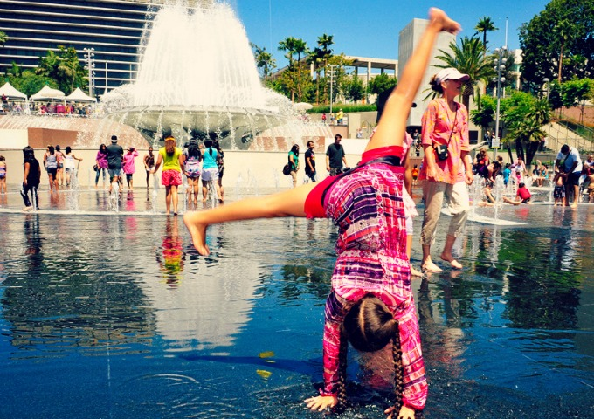
On those teenage summer days

Slide 19
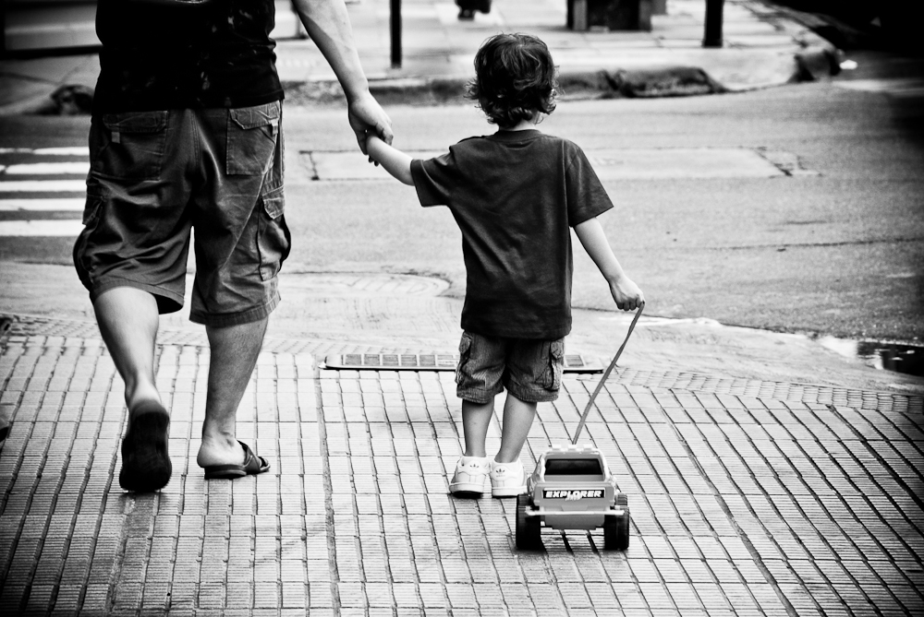
My daddy was a trucker

Slide 20
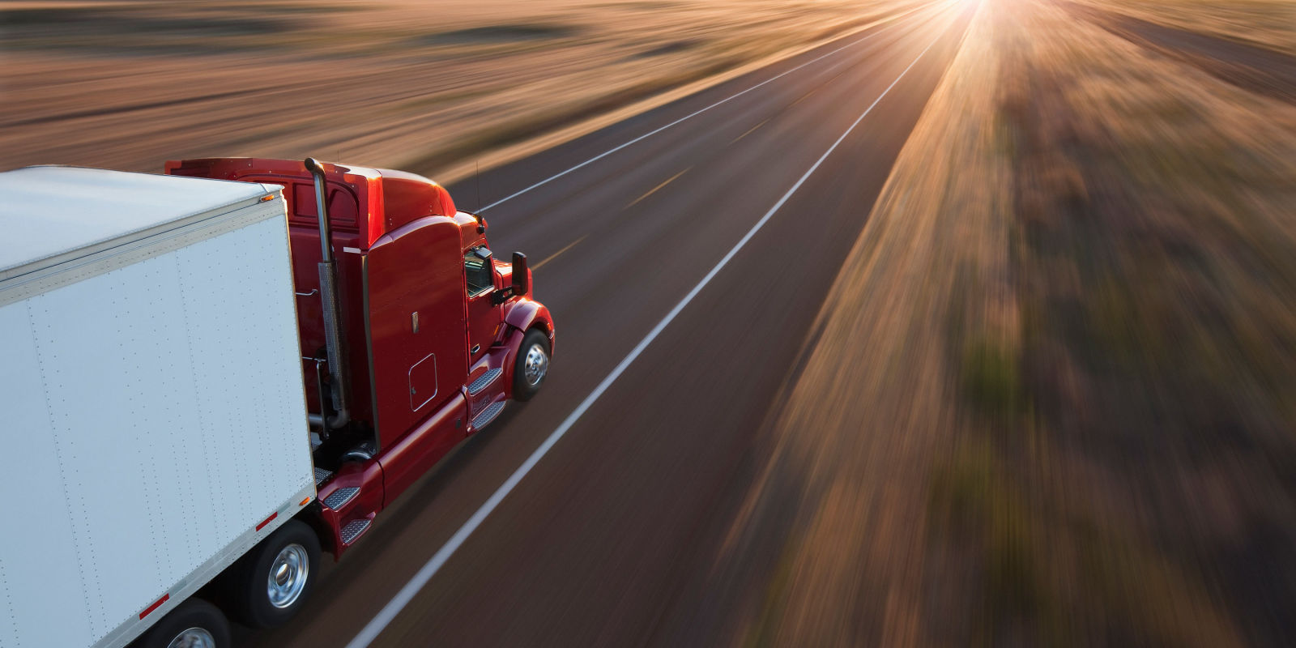
Hauling freight 12 hours a day

Slide 21
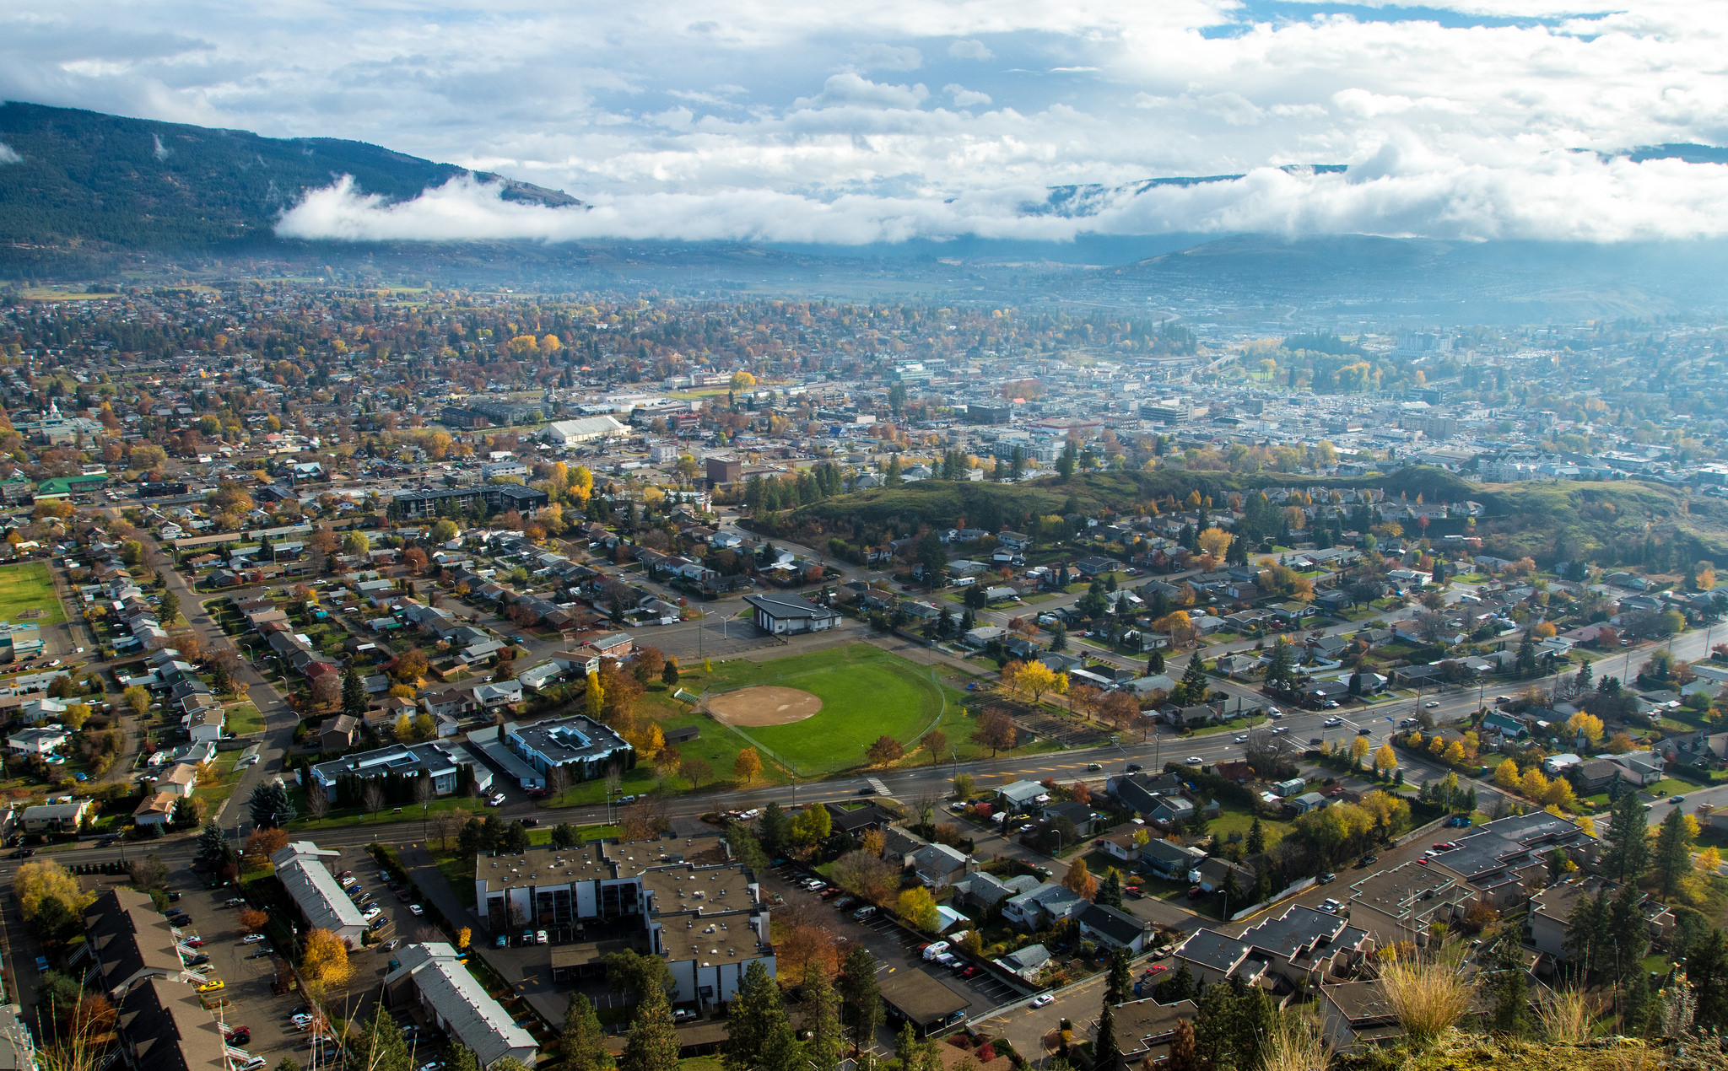
Sometimes he’d take me down to Vernon

Slide 22
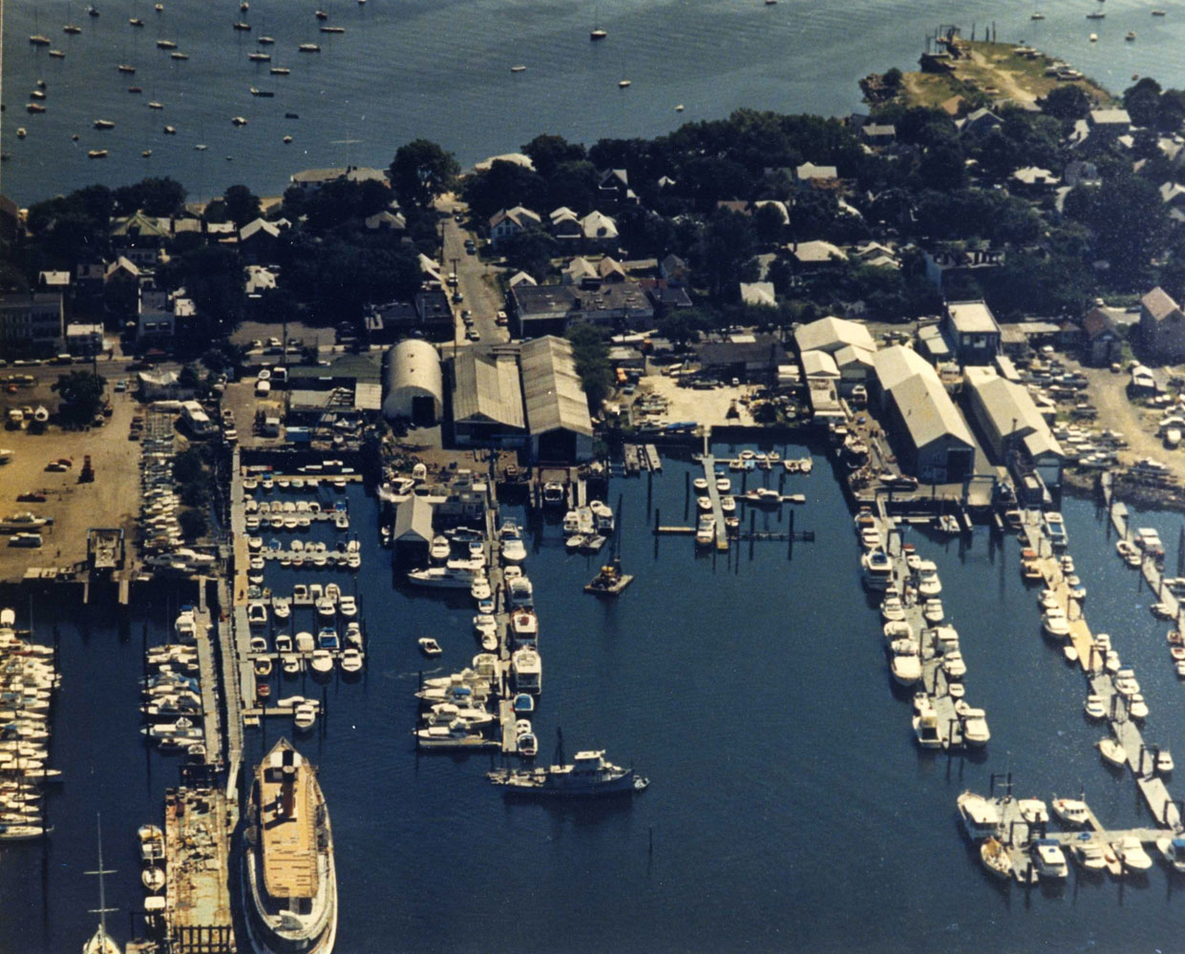
Or the shipyards in South Bay

Slide 23
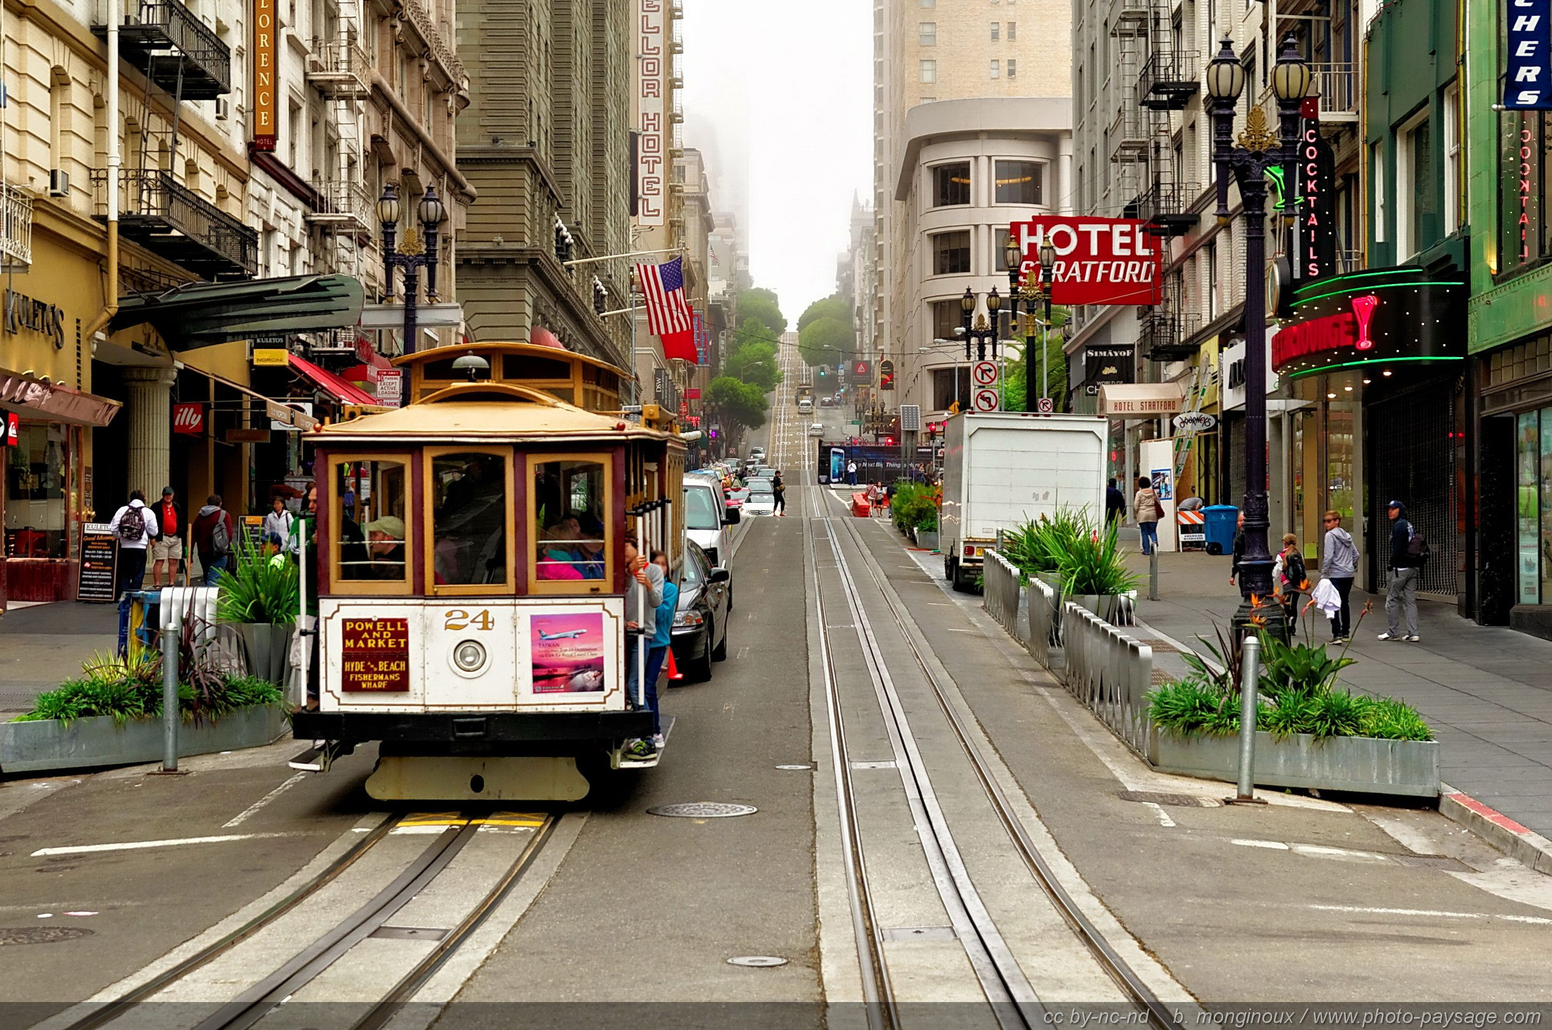
On the mean streets of L.A.
On those teenage summer days

Slide 24
On the mean streets of L.A.
On those teenage summer days

Slide 25
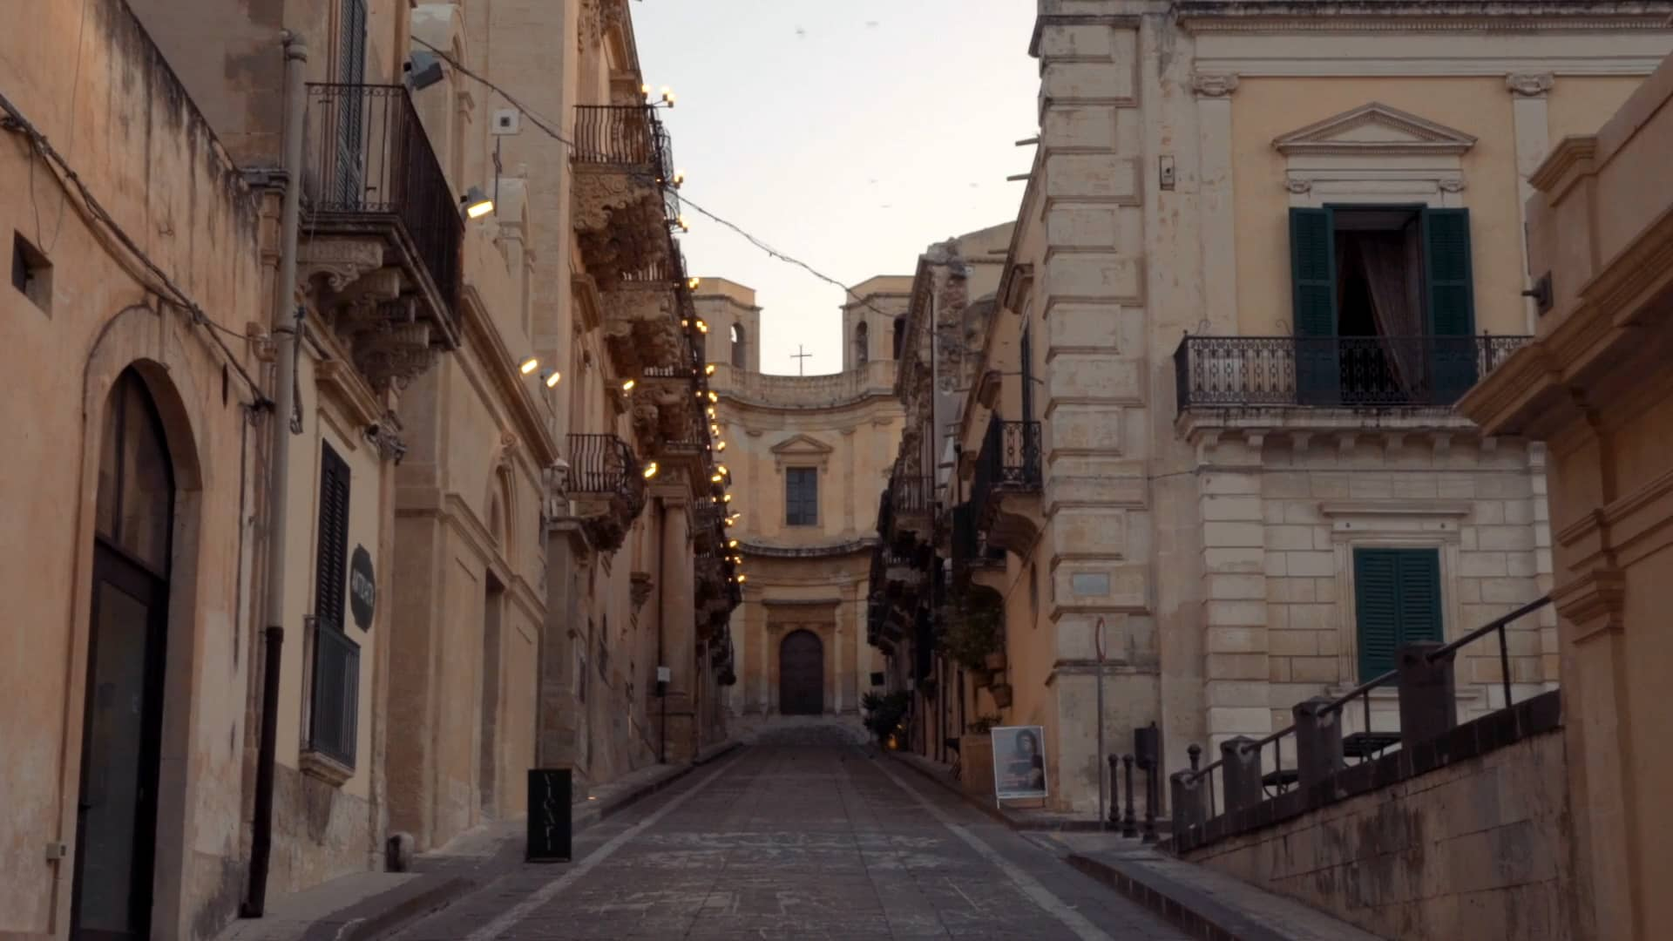
On the mean streets of L.A.
On those teenage summer days

Slide 26
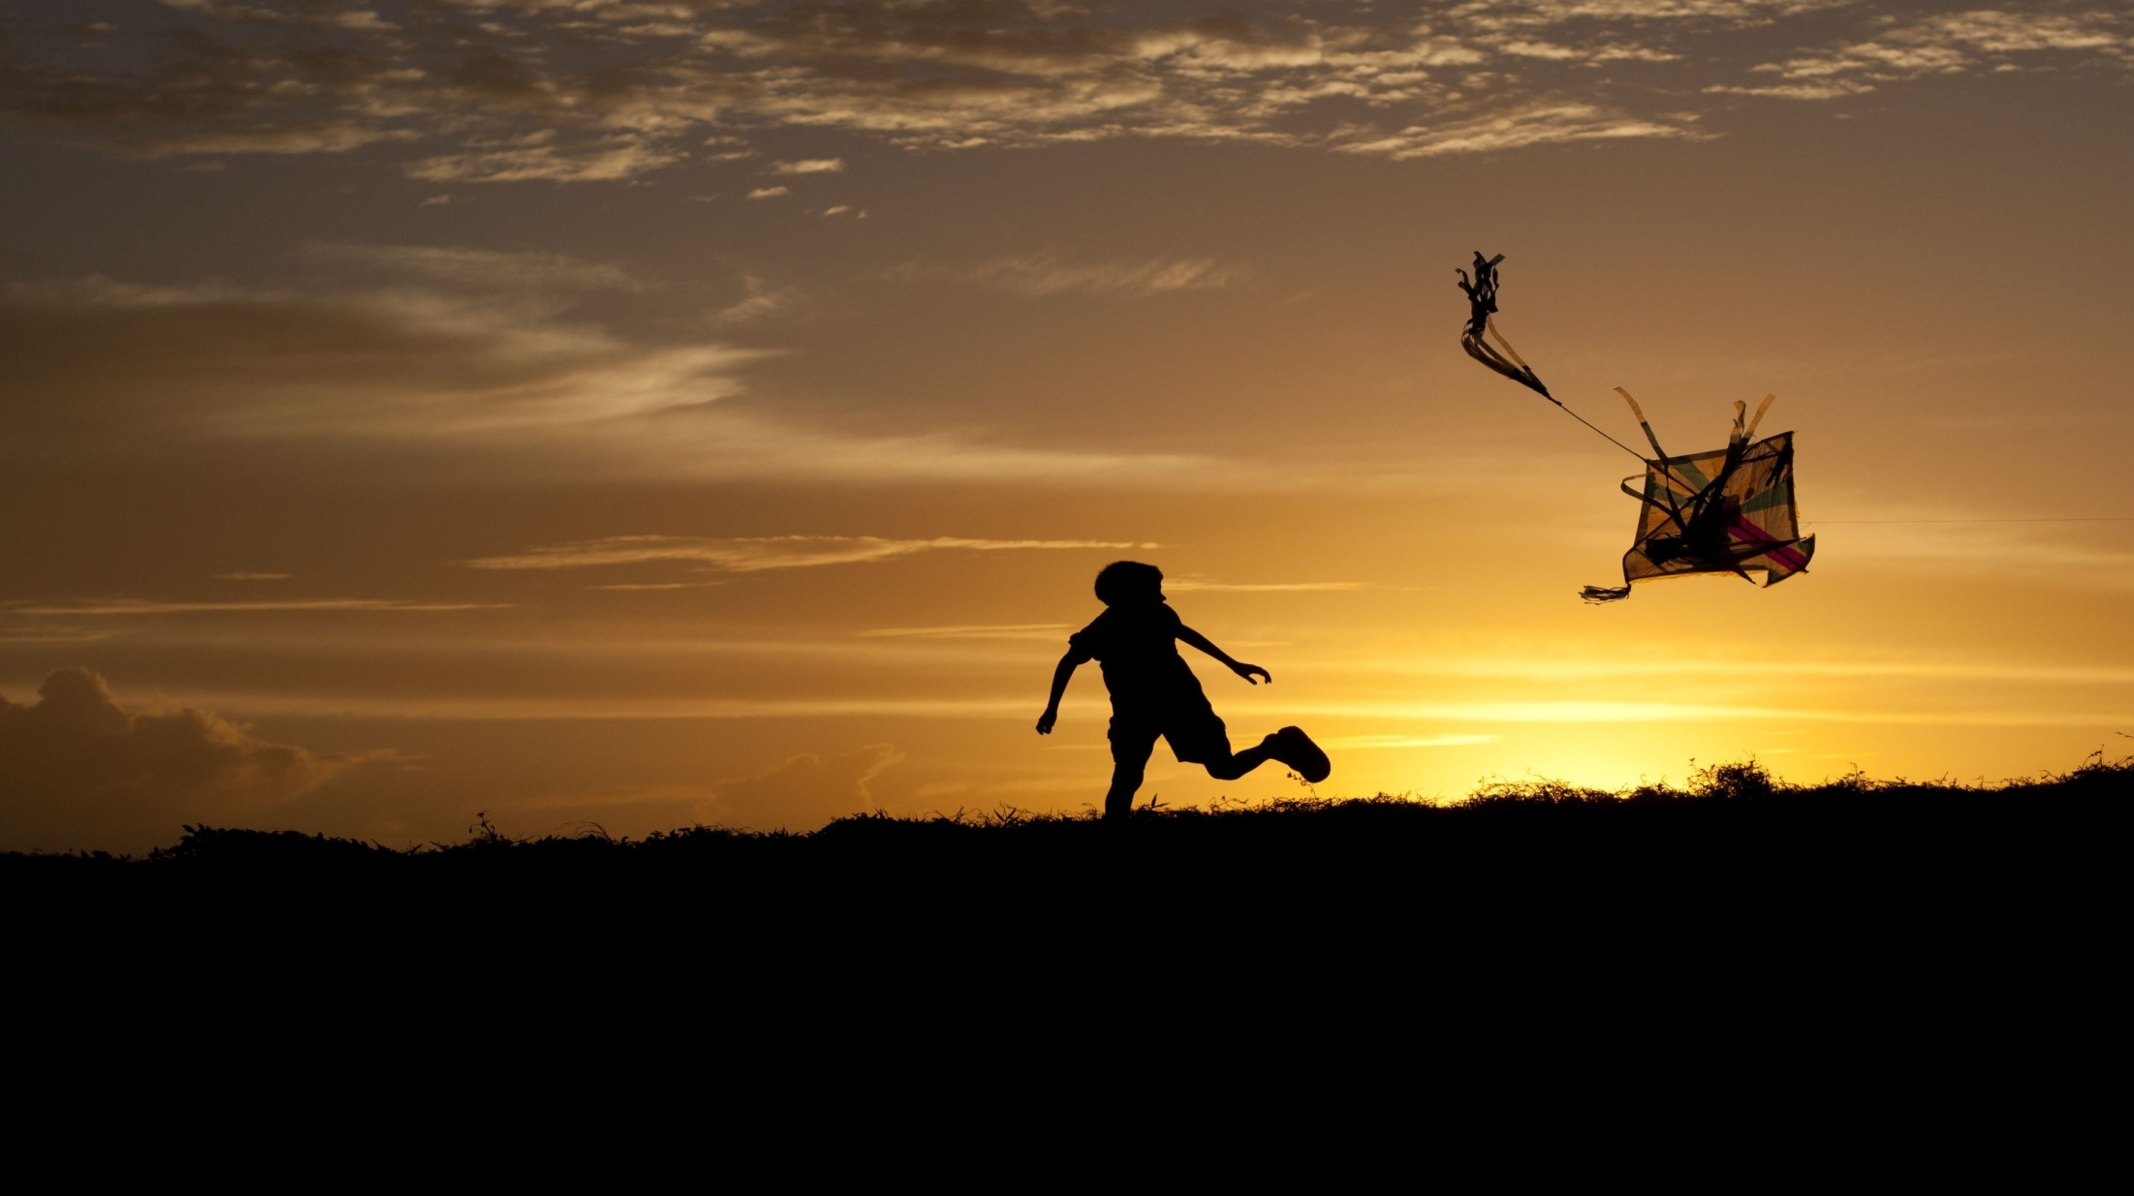
On the mean streets of L.A.
On those teenage summer days

