Slide 1
The AIP Publishing Portfolio & Navigating Scitation.org

Slide 2
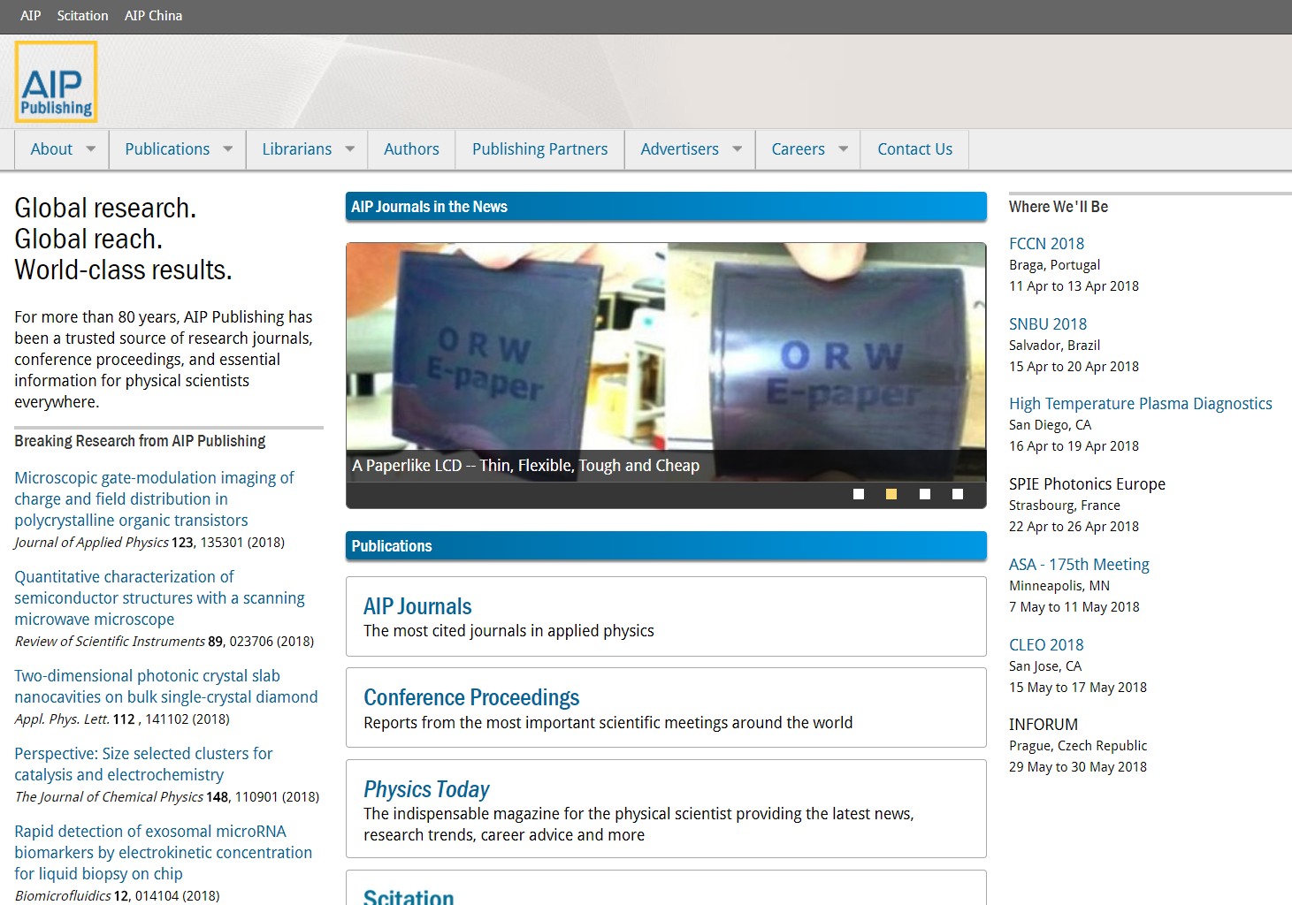
AIP Publishing Corporate Site (www.publishing.aip.org)
Provides insight into the history of AIP Publishing
Access to the latest company news
Breaking research from highly regarded journals
Author Services
Information about our Publishing Partners
Upcoming conferences
Links to:
  Scitation.org (content platform)
  AIP Conference Proceedings
  Physics Today
  Offers researchers

Slide 3
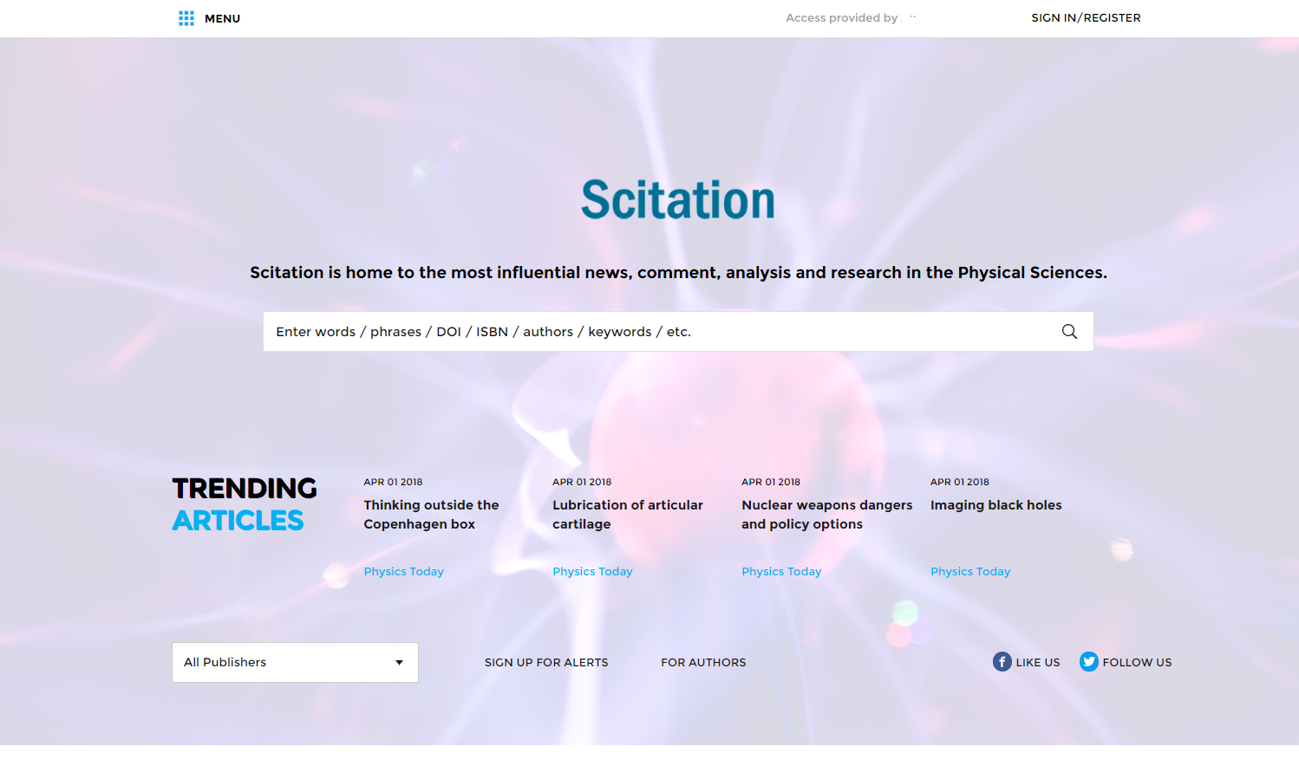
Content Platform (www.scitation.org)
Home to the most influential news, comment, analysis and research in the Physical Sciences
Platform for all AIP Publishing and Publishing Partner journals, including:
  The Journal of Rheology
  JVSTA
  JVSTB
  Biointerphases
  Surface Science Spectra
  The Journal of the Acoustical Society of America
  The American Journal of Physics
  The Physics teacher
  Chinese Journal of Chemical Physics
  Structural Dynamics
  Journal of Laser Applications

Slide 4
Navigating publishing.aip.org
Notes:
AIP Publishing’s corporate site provides librarians and researchers a starting point for obtaining information on the AIP Publishing portfolio, how to publish, librarian information, information about our publishing partners, and much more!

Slide 5
Homepage publishing.aip.org
Resources for institutional customers and administrators
Authors - how to publish, author services and guidelines
Publishing Partners – learn about the societies we partner with
Learn about AIPP, latest news, and publications available on Scitation.org
Upcoming conferences
Some of the latest research

Slide 6
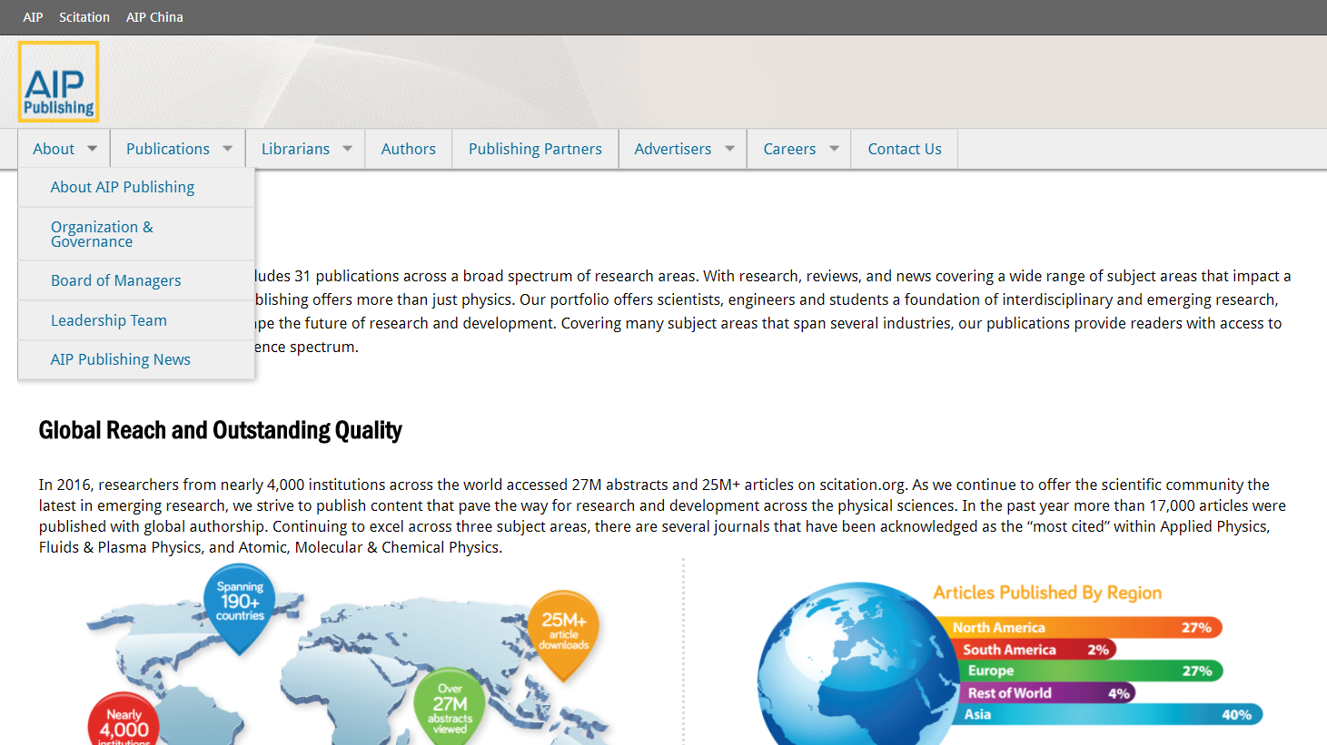
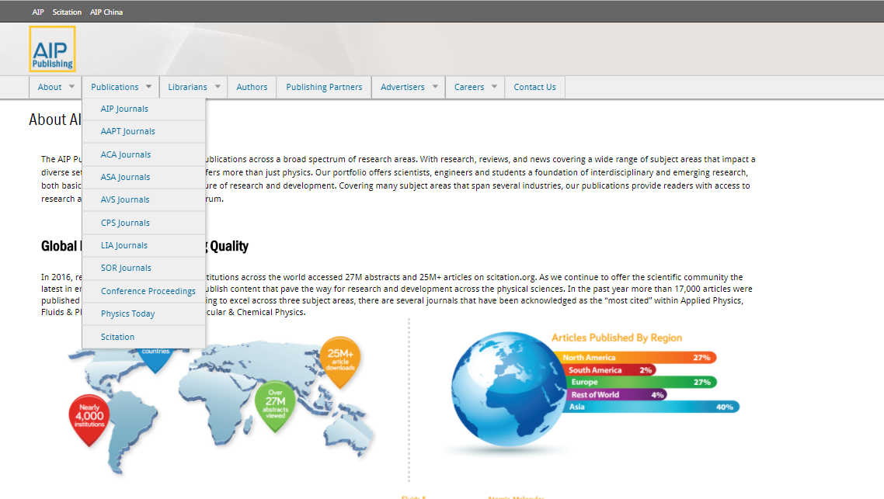
About AIP Publishing & Publications
About AIP Publishing
Learn about the history of AIP Publishing, board of managers and leadership
View the latest news and press releases from AIPP
Publications
Direct link to all AIP Publishing and Publishing Partner journals on Scitation.org

Slide 7
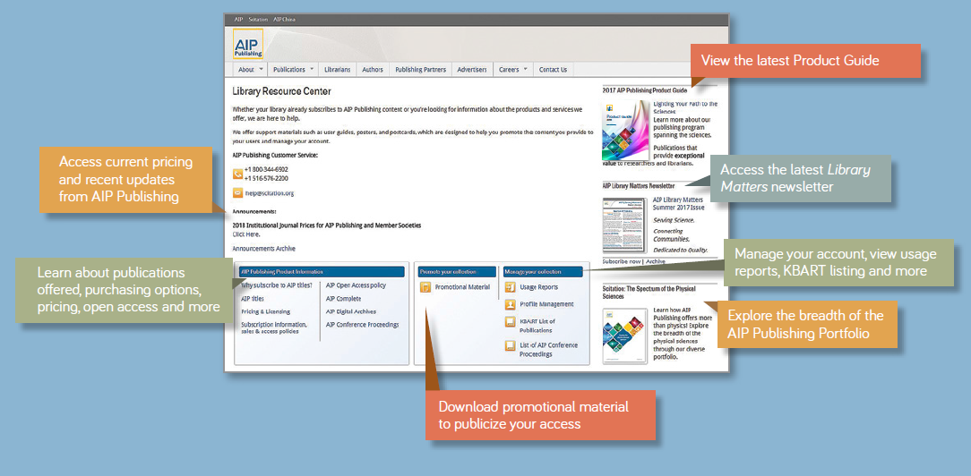
Library Resource Center publishing.aip.org/librarians
Notes:
AIP Publishing’s Library Resource Center is the administrative hub for your AIP Publishing account.
From publishing.aip.org/librarians, Administrators can:
View current pricing and licensing policies
Download promotional, user awareness material
Access usage reports
View the latest Library Matters newsletter
Link to AIP Publishing’s KBART file and list of AIP Conference Proceedings
Learn about new products and offers

Slide 8
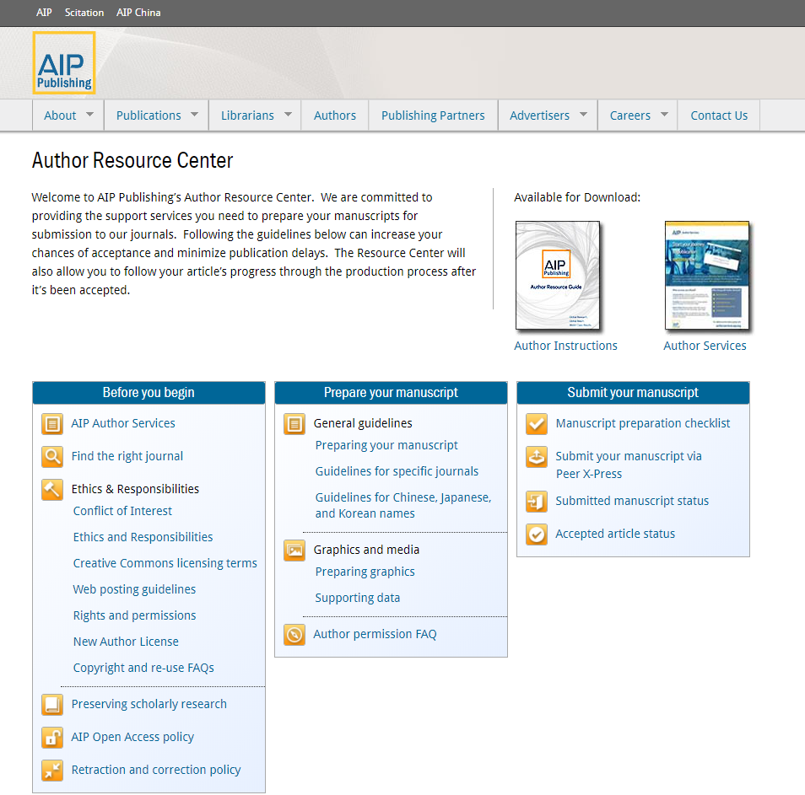
Author Resource Center
Provides authors with necessary tools and resources for when you are submitting a manuscript
Highlights available author resources
Learn about:
  How to prepare a manuscript
  Submission guidelines
  OA policy
  AIP Author Services

Slide 9
Publishing Options
AIP Publishing Author Select & Open Access
  Authors pay fee to support publication and archiving costs
  Articles free in perpetuity to any online user
  Author Select – hybrid author-pays model for any subscription journal
  Open Access – available for OA AIP journals
Traditional Submissions
  No page or other fees charged
  Articles available via subscriptions or pay-per-view

Slide 10
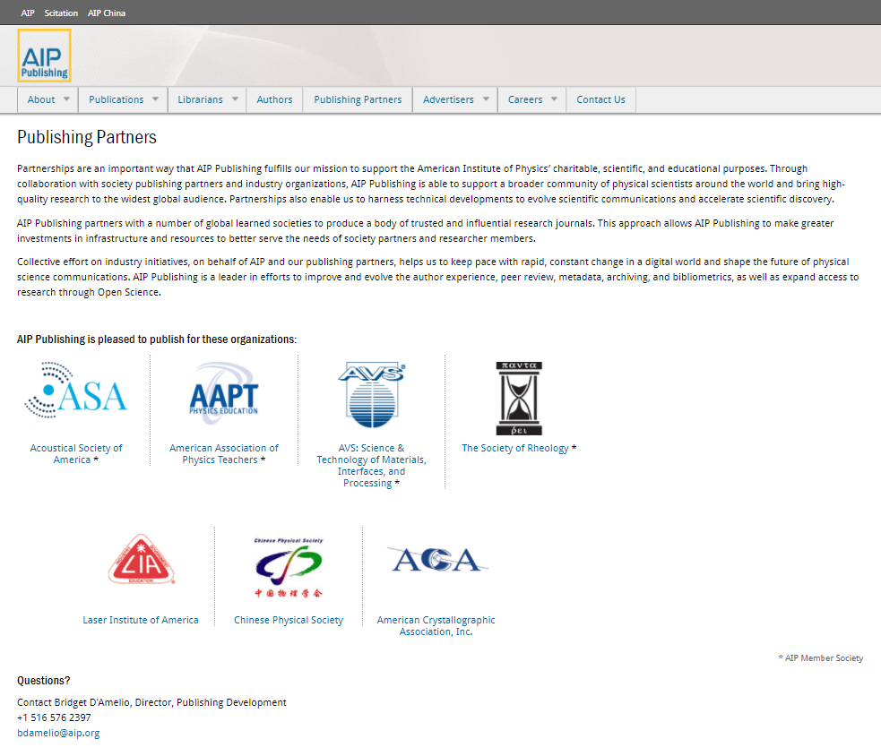
Publishing Partners
Highlighting the AIP Publishing’s publishing partnership seven organizations, including:
Acoustical Society of America
American Association of Physics Teachers
AVS: Science & Technology of Materials, Interfaces, and Processing
The Society of Rheology
Laser Institute of America
Chinese Physical Society
American Crystallographic Association, Inc.

Slide 11
Navigating Scitation.org

Slide 12
AIP Publishing Portfolio
Online access available to…
24 journals in the physical sciences
  8 published on behalf of/ in conjunction with Publishing Partners
  5 Open Access journals
2 magazines (Physics Today and Computing in Science & Engineering)
AIP Conference Proceedings – back to 1970 including 160+
Digital Archives – dates back to 1930 and includes 280K⁺ articles
All on one platform – scitation.org

Slide 13
Platform Improvements since Dec 2016
Redesigned page layout
Optimized display
Improved speed
New figure viewer
Improved linking
More collaboration tools
Rebuilt library admin access site
To ensure a personalized experience on Scitation.org, take a moment to create a profile by visiting:
https://www.scitation.org/action/registration
Notes:
Redesigned page layout - for better article readability
Optimized display – across mobile devices and browsers
Improved speed – faster navigation and search functionality
New figure viewer - to explore visual content
Improved linking - including free access to all supplementary material
More collaboration tools - simplifying sharing with colleagues and across social networks
Rebuilt library admin access site - for more efficient account management

Slide 14
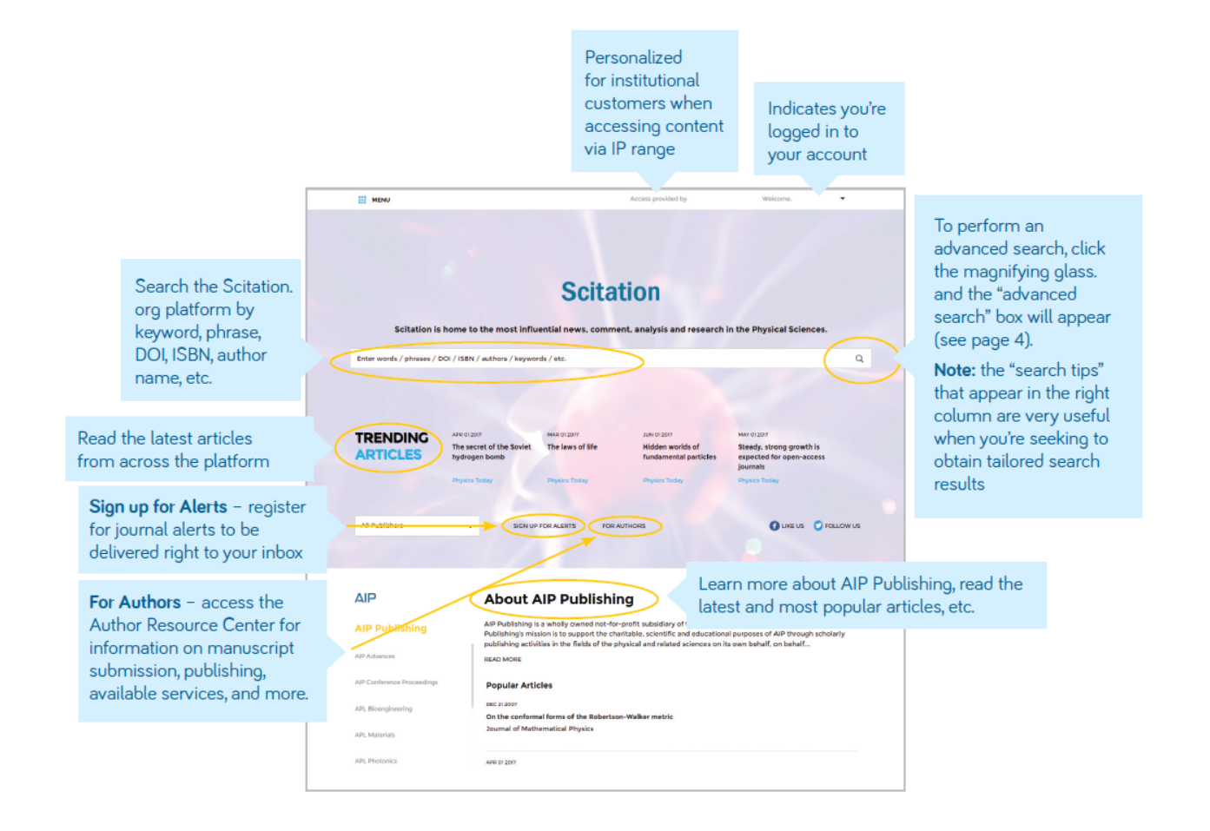
Navigating the Homepage
From the homepage, users are able to:

Slide 15
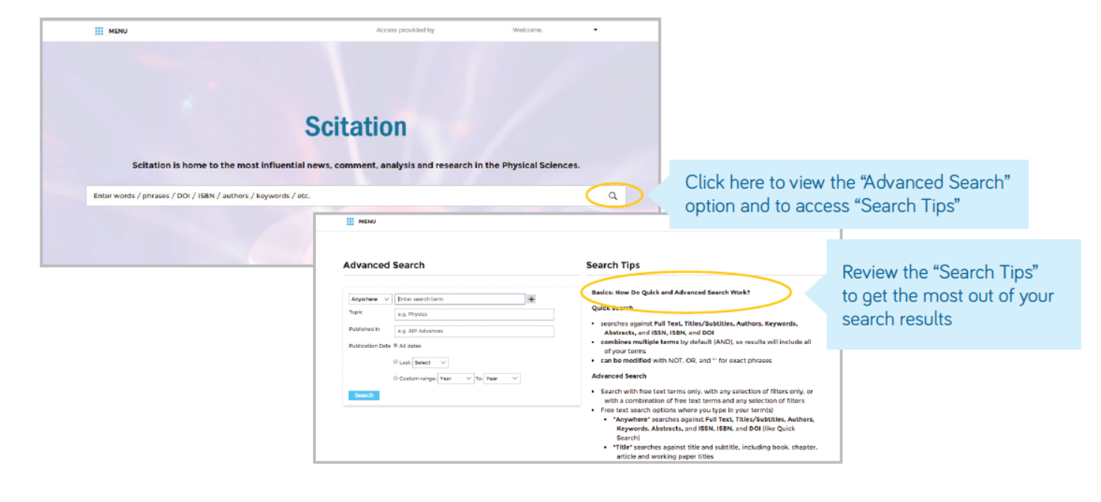
Advanced Search
Allows you to search the Scitation Platform in one-go
Search by keyword and phrase, DOI and ISBN #, author, topic, publication and publication date
“Search tips” – offer the best way to get what you want out of your search

Slide 16
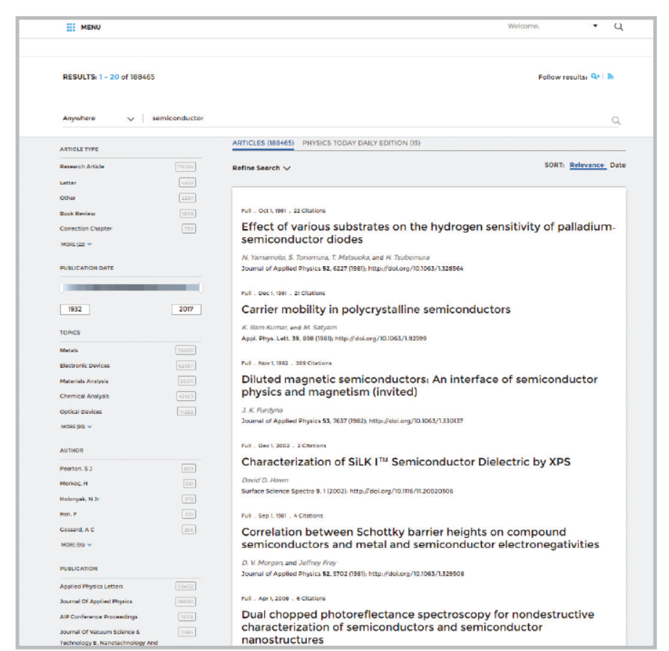
Search Results
When search results appear, you are able to:
Filter by article type, publication date, topic, author name, or publication
Sort by relevance or publication date

Slide 17
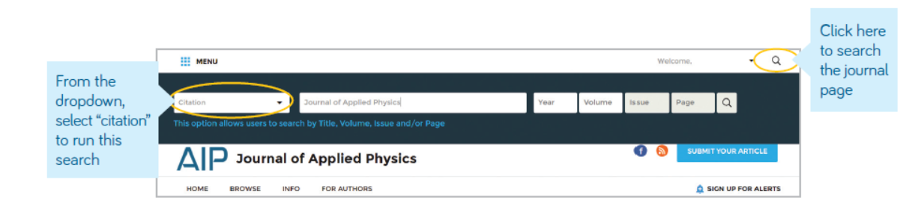
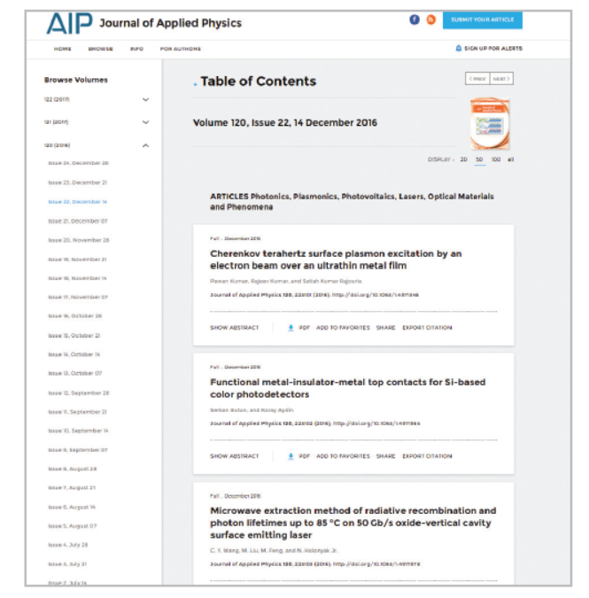
Article Search by Citation from Journal Homepage
For the most accurate results, fill in the journal name, year of publication, volume and page number

Slide 18
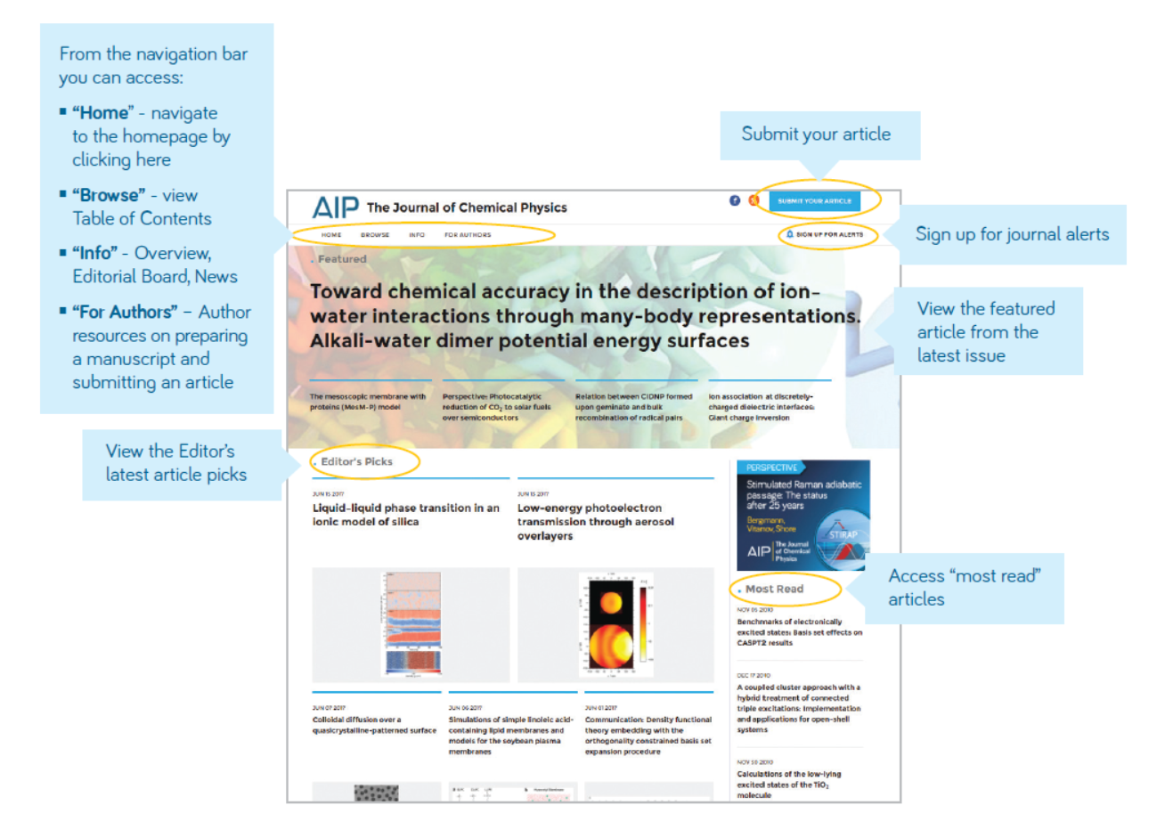
Journal Homepage: Navigating the Page

Slide 19
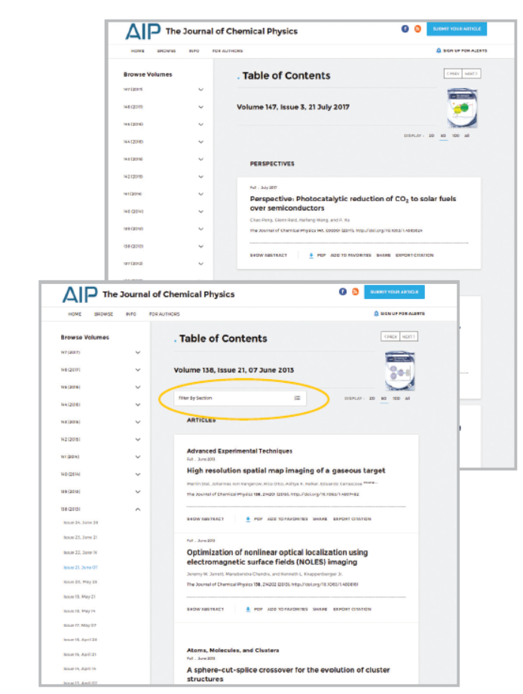
Journal Homepage: Table of Content (TOC)
View, download, “add to favorites” or “share” your article of choice
“Filter by Section” populates the sections and sub-sections within each TOC

Slide 20
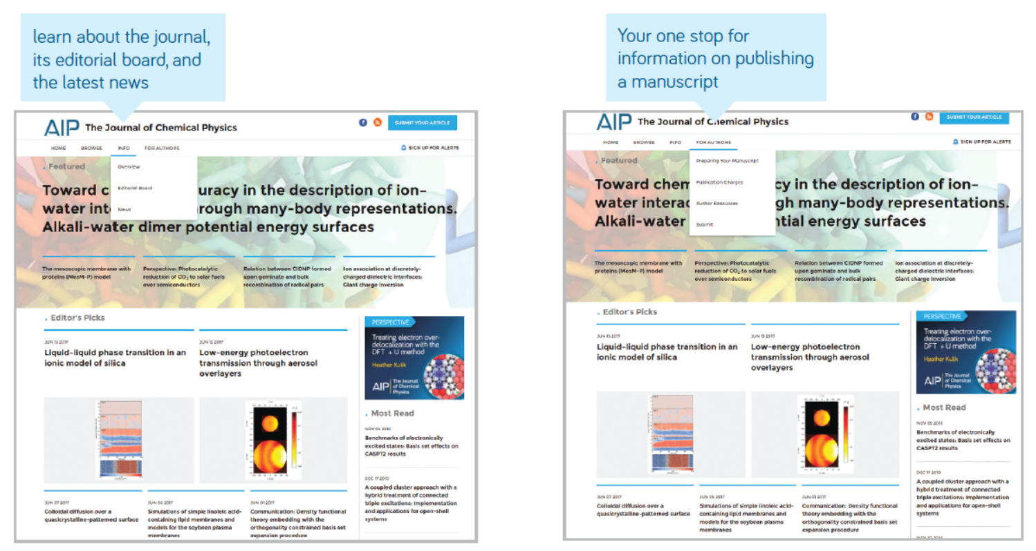
Journal Homepage: Navigation Bar

Slide 21
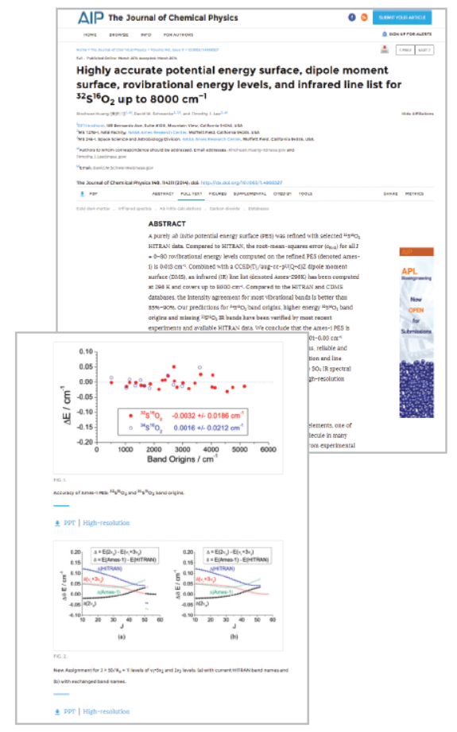
Viewing an Article
From an article, users can:
  Save searches
  Sign up for RSS feeds
  Download an article as a PDF
  Sign up for journal alerts
  View author affiliations
  View and download article citations
  Add to your “favorites”
  “Share” the article with peers
  View article metrics
  Access related articles
In most cases, articles are available as HTML or PDF
Article graphs/ charts can be downloaded to PPT
Notes:
Users accessing articles through their institution (IP authenticated) have the ability to do so without creating a profile. However to benefit from all tools available we encourage users to create a profile. From an article, users can:
Save searches
Sign up for RSS feeds
Download an article as a PDF
Sign up for journal alerts
View author affiliations
View and download article citations
Add to your “favorites”
“Share” the article with peers
View article metrics
Access related articles
Most articles are accessible as HTML or PDF. If only one format is available, the navigation bar will be updated to reflect the version offered. If available, supplemental information will be noted in the navigation bar in line with “cited by”.

Slide 22
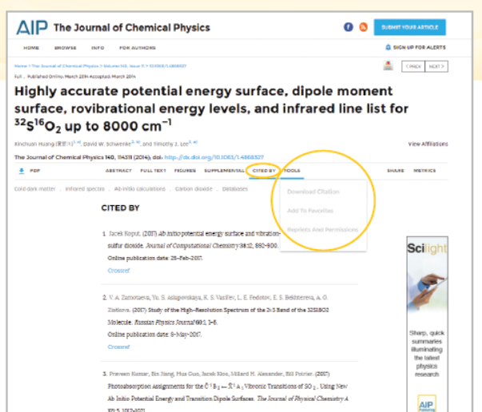
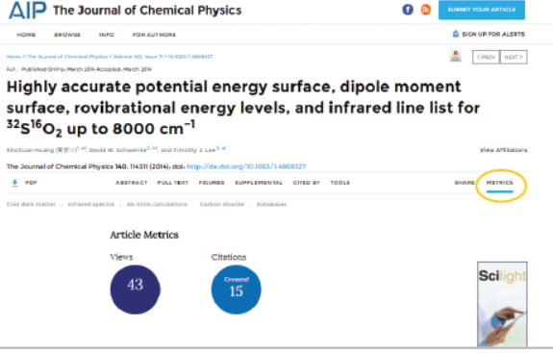
Article Citations, Tools & Metrics
Article citations can be viewed and downloaded
Articles can be added to “favorites”
Article metrics are recorded in real-time and updated on the article page daily
  Cumulative since Dec 2016

Slide 23
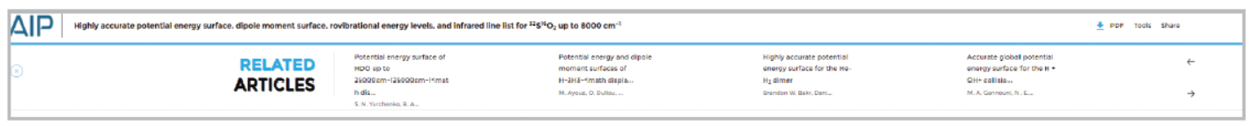
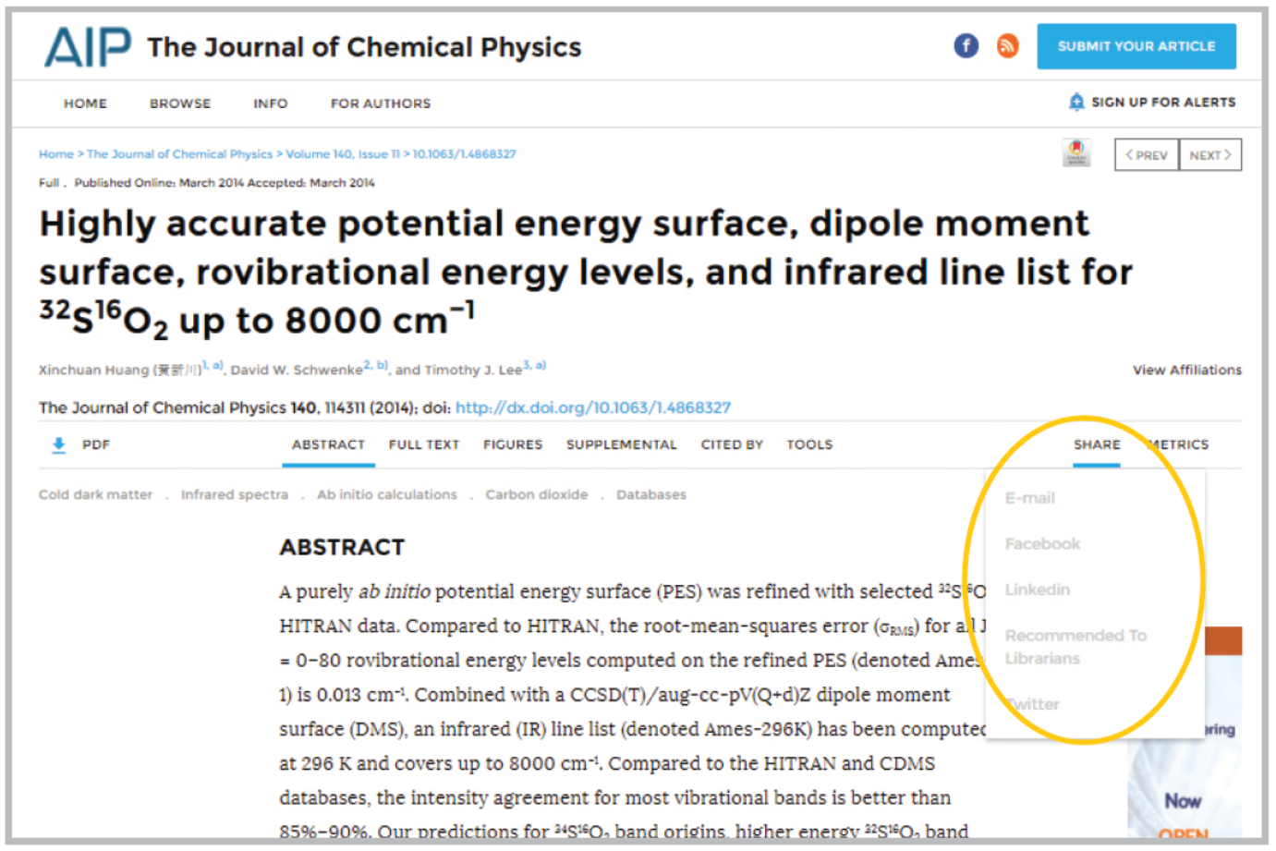
Related Article & Sharing an Article
Related articles appear at the top of the screen
All articles are “shareable” via social media and email

Slide 24
Have a question?
Contact AIP Publishing today!
https://www.scitation.org/help
PDF version of this User Guide:
https://publishing.aip.org/librarians/userguides

