Slide 1
“新课标新教材新高考”创新教学设计
六要素整合理念下的以读促写
——以2019人教版必修二Unit5 Reading for Writing为例
授课教师：吴嘉慧（广东广雅中学）
2021年4月
Notes:
各位专家和同行好，我是来自广东广雅中学英语科的吴嘉慧老师，今天我带来的教学设计是：六要素整合理念下的以读促写，以2019年人教版必修二Unit5 Reading for writing为例

Slide 2
Content
1. 六要素整合理念
2. 文本分析与课时目标
3. 单元整体教学理念下的课堂导入
4. 读：听前预测、听取大意
5. 写前：写作任务、写作指导（内容、结构、语言）
6. 写作
7. 写后：润色、同伴互评、分享、范文赏析、作业
Notes:
我的说课将包含以下7个方面，呈现在六要素整合理念下以读促写的设计逻辑。首先，我会简单谈谈课标中的六要素整合理念；第二部分是对文本的分析与课时目标；第三部分呈现如何基于单元整体教学理念进行课堂导入；第四部分展示如何根据语篇特征进行恰当的教学策略选择，帮助学生深化对阅读篇章的理解；第五部分聚焦写前环节的指导，关注内容、结构、语言的脚手架搭建；第六部分展现学生如何在脚手架支撑下写作；最后一个部分呈现写后的各个环节，包括润色、同伴互评、分享、范文赏析与作业。

Slide 3
1. 六要素整合理念
Notes:
第一部分，我将回顾新版课标中的六要素整合理念。

Slide 4
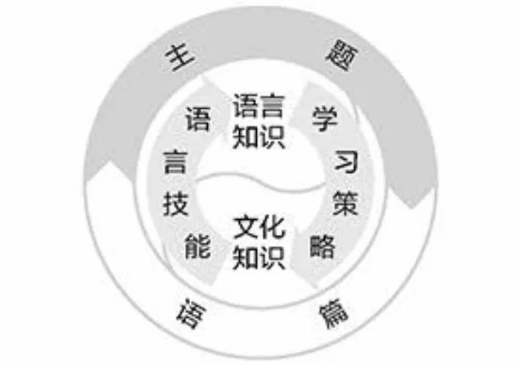
学生围绕某一具体的主题语境，基于不同类型的语篇，在解决问题的过程中，运用语言技能获取、梳理、整合语言知识和文化知识，深化对语言的理解，重视对语篇的赏析，比较和探究文化内涵，汲取文化精华；同时，尝试运用所学语言创造性地表达个人意图、观点和态度，并通过运用各种学习策略，提高理解和表达的效果，由此构成六要素整合、指向学科核心素养发展的英语学习活动观。（教育部，2018）
六要素整合的英语课程内容
A
B
C
学习理解
应用实践
迁移创新
Notes:
所谓的整合六要素教学，是指要求学生学生围绕某一具体的主题语境，基于不同类型的语篇，在解决问题的过程中，运用语言技能获取、梳理、整合语言知识和文化知识，深化对语言的理解，重视对语篇的赏析，比较和探究文化内涵，汲取文化精华；同时，尝试运用所学语言创造性地表达个人意图、观点和态度，并通过运用各种学习策略，提高理解和表达的效果，由此构成六要素整合、指向学科核心素养发展的英语学习活动观。这需要教师在设计具体的课时内容时，时刻围绕主题意义探究这个核心任务，以具体的语篇为依托开展教学活动设计。教学活动应该是有层次的，包含学习理解、应用实践、迁移创新三个维度，综合指向培养学生英语核心素养。本课例的设计即基于此理念。

Slide 5
2. 文本分析与课时目标
Notes:
课标提出，教学要以具体的语篇为依托。第二部分，我将从what、why、how三方面进行具体的文本分析，并基于分析结果、学生学情、教材理念确定课时目标。

Slide 6
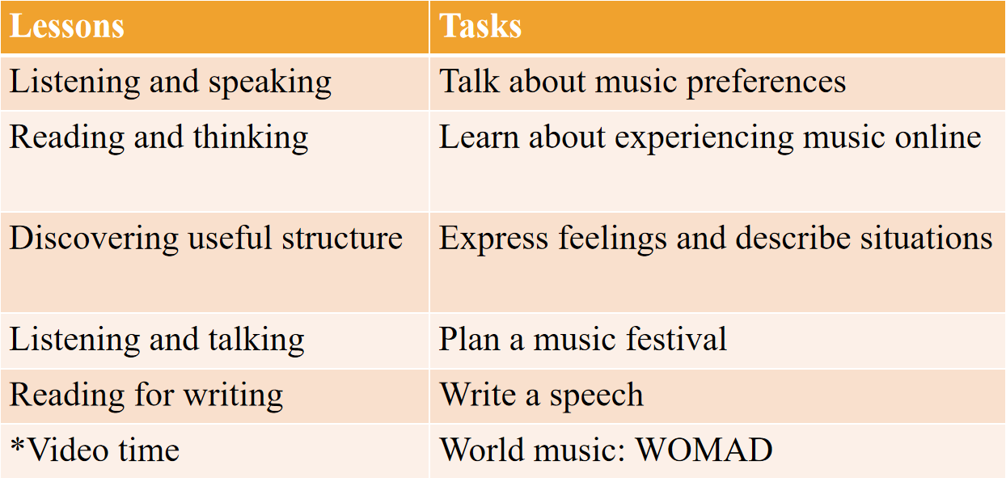
Unit 5 Music
the power of music
Notes:
第五单元主题为music，各个板块与目标如表格所示，从教材逻辑来看，本单元的单元主线我们可以确定为the power of music，音乐的力量，让学生通过本单元的学习后能了解音乐不同方面的功能。本课例聚焦教材第五个板块reading for writing 部分。

Slide 7
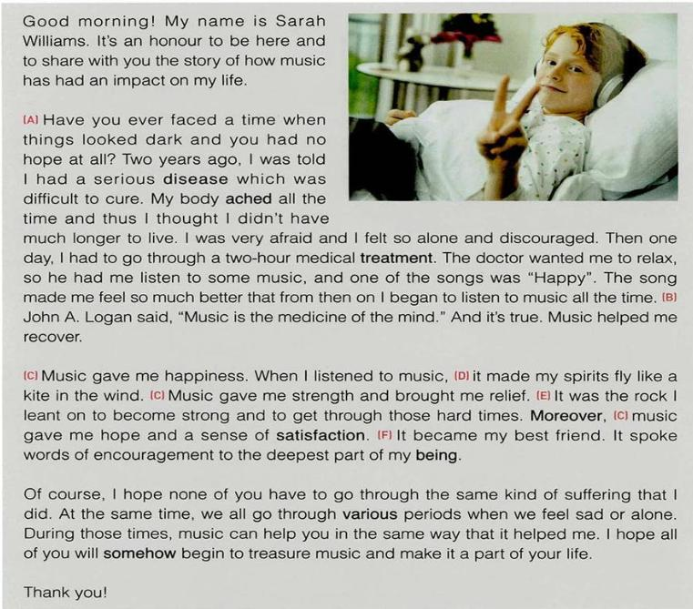
【What】Reading部分是一篇演讲稿，演讲者Sarah Williams讲述了自己身患重病心情沮丧，在接受治疗时医生让她听音乐放松，她因此从音乐中汲取到快乐、慰藉、力量、希望与满足感。在音乐的帮助下，她慢慢走向恢复，并呼吁大家在人生遇到困难与挫折时，可以多听音乐，让音乐成为自己生活的一部分。
Notes:
在what方面，本课时选材新版人教版教材必修二U5Reading for Writing，阅读部分是一篇演讲稿，演讲者Sarah Williams讲述了自己身患重病心情沮丧，在接受治疗时医生让她听音乐放松，她因此从音乐中汲取到快乐、慰藉、力量、希望与满足感。在音乐的帮助下，她慢慢走向恢复，并呼吁大家在人生遇到困难与挫折时，可以多听音乐，让音乐成为自己生活的一部分。写作部分要求学生仿写演讲稿，分享音乐如何改变自己或身边人的生活。

Slide 8
【Why】本单元主题语境为音乐，主要引导学生了解音乐的力量。学生在学习本单元之前普遍都熟悉音乐的娱乐作用，Reading for Writing部分则聚焦音乐能帮助患者康复的治愈功能，这一功能是学生日常生活较少接触到的，是学生较为陌生的。因此本部分语篇选用演讲稿的语篇类型，让学生在阅读的过程中有与演讲者Sarah Williams面对面的感觉，深化学生对语篇目的的认识。
Notes:
那么文本为什么采用演讲稿形式呢？本单元主题语境为音乐，主要引导学生了解音乐的力量。学生在学习本单元之前普遍都熟悉音乐的娱乐作用，Reading for Writing部分则聚焦音乐能帮助患者康复的治愈功能，这一功能是学生日常生活较少接触到的，是学生较为陌生的。因此本部分语篇选用演讲稿的语篇类型，让学生在阅读的过程中有与演讲者Sarah Williams面对面的感觉，深化学生对语篇目的的认识。

Slide 9
【How】本文是一篇演讲稿，结构清晰，语言生活有吸引力与号召力。结构方面，整篇演讲稿遵循Welcome the audience--Introduce yourself--Propose the topic--Personal anecdote--Personal feelings--Close the speech--Thank the audience at the end的语篇逻辑结构；语言方面，运用了丰富的修辞手段：暗喻、明喻、拟人、引用名言、排比、设问，演讲色彩浓厚。
Notes:
聚焦到文本的文体特征、内容结构和语言特点方面，本文是一篇演讲稿，结构清晰，语言生活有吸引力与号召力。结构方面，整篇演讲稿遵循Welcome the audience--Introduce yourself--Propose the topic--Personal anecdote--Personal feelings--Close the speech--Thank the audience at the end的语篇逻辑结构；语言方面，运用了丰富的修辞手段：暗喻、明喻、拟人、引用名言、排比、设问，演讲色彩浓厚。这些都需要学生在阅读时深度挖掘，为有效仿写搭建脚手架。

Slide 10
Learning objectives
After learning this part（80 mins）, students will be able to:
1. Understand how music has helped Sarah Williams recover from her illness;
2. Analyze the structure and rhetorical devices of a speech;
3. Connect the power of music with their own life experience through referring to others' experiences;
4. Create their own speech on how music can help them/someone they know;
5. Edit their peers’ writing based on what they learned in this lesson;
6. Appreciate the power of music through delivering/sharing their own speech.
Notes:
基于以上的文本分析，在以读促写环节，我确定了以下教学目标，从理解分析到写前构思，从写作互评到写后分享，试图在真实情景下构建完整的以读促写环节链。

Slide 11
3. 单元整体教学理念下的课堂导入
Notes:
第三部分，我们聚焦如何基于单元整体教学理念进行课堂导入。

Slide 12
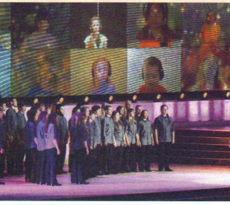
Lead in
基于单元大观念，围绕主题语境
Reading and thinking: The Virtual Choir
The power of music lies in ______________________ and thus making the world ____________.
As one virtual choir member said, “Music helps me to ... forget my problems. With music, I become someone else.”
connecting people together
a better place
How can music help people in their personal struggles?
Notes:
如前所述，本单元主题语境为音乐，主要引导学生了解音乐的力量。Reading for thinking部分，学生阅读了一篇介绍性说明文，了解到虚拟合唱团的由来与影响，从而了解音乐的群体连接作用。而本课时的Reading for writing部分则聚焦音乐对特殊人群的个体作用，因而在导入环节，我选择了主阅读篇章中的一句话，让学生思考：How can music help people in their personal struggles? 引导学生从音乐的群体力量转而关注音乐的个体力量，基于单元主题语境实现单元内课时逻辑的衔接。

Slide 13
4. 读：听前预测、听取大意
Notes:
第四部分，我将呈现如何基于语篇特点选择恰当的教学策略。

Slide 14
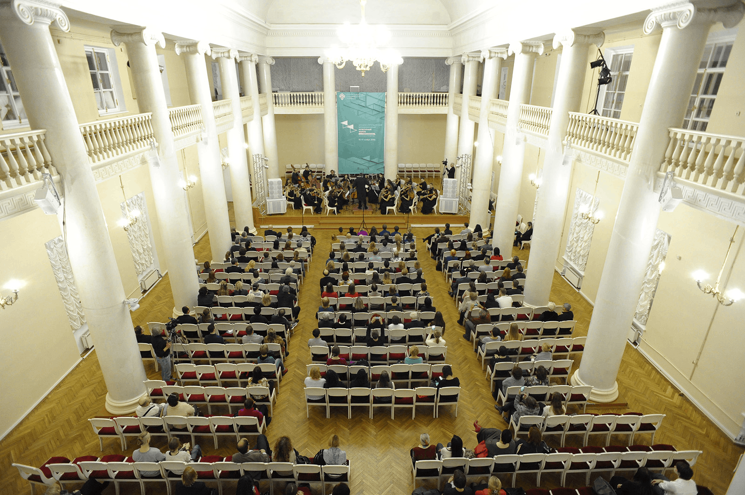
Lead in
创设与主题意义密切相关的语境
We are invited to an International Music Forum to learn about the power of music.
The next speaker: Sarah Williams.
Notes:
新版课标强调，要基于主题语境创设与之相关的真实情景。教材板块并没有给出情景，学生阅读时无法事前了解阅读目的。因而，在课堂导入环节，我创设了一个相关的主题语境，让学生想象，自己被邀请到国际音乐研讨会现场，一起了解音乐的力量，接下来我们要聆听一个演讲者对于音乐力量的演讲。

Slide 15
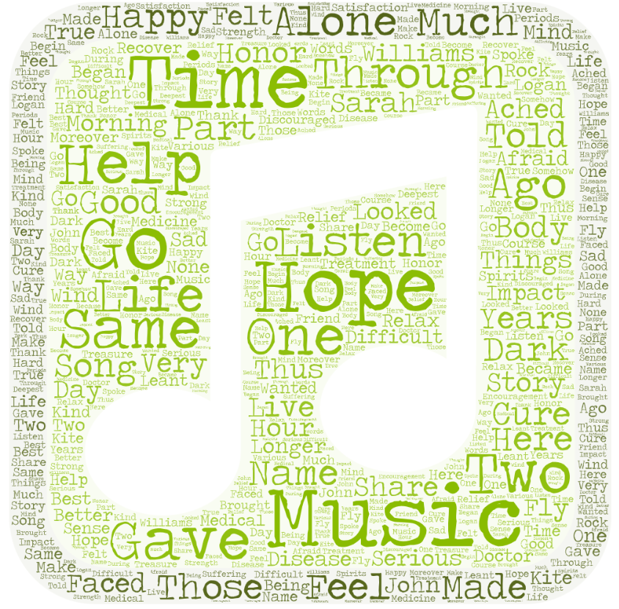
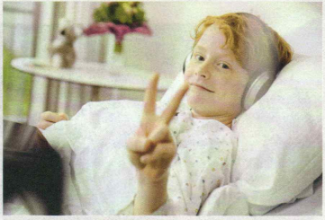
Predict
运用语言技能（看、预测）理解语篇
Sarah Williams
1. What is special about the speaker?
2. How do you think music helped her?
Notes:
在读前预测环节，学生要看教材配图，了解演讲者的基本情况，同时通过看词汇云图，发现文本关键词，从而预测文本大意

Slide 16
Listen for main idea
Music is the medicine of the mind.
--John A. Logan
根据语篇类型选择适合的语言技能
Music gave her happiness, strength, relief, hope and a sense of satisfaction.
Her advice to others is to use music help when they have problems.
Sarah had a serious disease which was difficult to cure.
What was Sarah's problem?
How did music help her during her difficult time?
What is her advie to others?
Notes:
虽然板块大标题为Reading for writing，但基于语篇文体是演讲稿的特点，我将让学生听演讲稿，回答教材上的三个阅读问题，从而了解文本大意，这体现了基于语篇特征选择恰当的教学策略思想。

Slide 17
5. 写前：写作任务、
写作指导（内容、结构、语言）
Notes:
第五部分是课时的重点，呈现如何为学生搭建有效的脚手架支撑写作。

Slide 18
创设与主题意义密切相关的语境，让学生在解决问题的过程中理解与表达
Writing task
The International Music Forum has also invited us to make a speech about the power of music to other high school students.
A
Content
B
Structure
C
Language
Notes:
写作需要明确写作目的与写作对象。沿袭读前的情景设置，我创设了一个同个场合下，学生上台演讲分享自己的经历与观点的情景，帮助学生明确为什么而写，为谁而写，培养学生写作的读者意识。在情景的铺垫下，我将从内容、结构、语言三方面让学生深入挖掘阅读文本，为写作搭建坚实的脚手架。

Slide 19
1. Content
运用学习策略（网上资源），提高表达效果
https://vocal.media/beat/how-music-changed-my-life
(1) Music helps us overcome our stress and anxiety and become optimistic towards life.
Notes:
内容方面，由于写作主题，即音乐改变人生，对学生而言相对陌生，因而，我选取了网络上的真人分享，给学生补充额外的语料，帮助学生拓展写作内容思路，切实提高学生写作的表达效果。这体现了六要素当中的学习策略恰当选用。

Slide 20
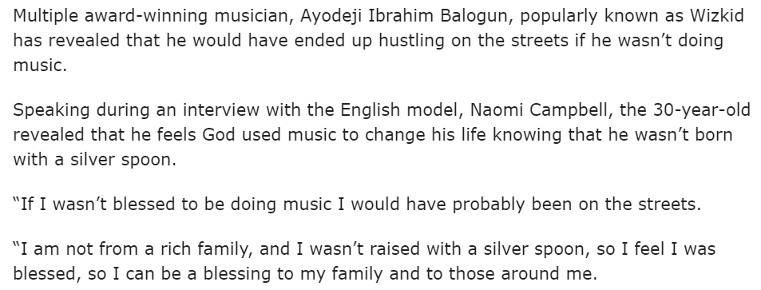
1. Content
(2) Music helps us figure out our career path to be a singer/music producer.
https://www.pmnewsnigeria.com/2020/12/17/music-changed-my-life-i-would-have-been-on-street-wizkid/

Slide 21
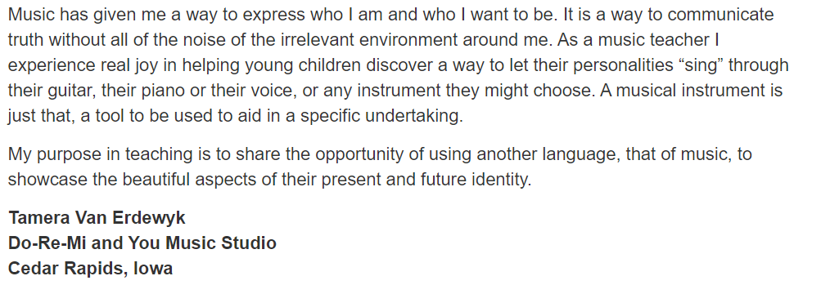
1. Content
(3) Music helps us find out our identity so that we can live a more meaningful life.
https://makingmusicmag.com/how-has-playing-music-changed-your-life/

Slide 22
1. Content
https://greatergood.berkeley.edu/article/item/four_ways_music_strengthens_social_bonds
(4) Music helps us connect to others and have a sense of belonging.

Slide 23
1. Content
探究文化内涵（“Music is the universal language of mankind”）
How has music helped you/someone you know? How does music make you/others feel?
(5) Music helps us recover from our illness and keeps us healthy.
(1) Music helps us overcome our stress and anxiety and become optimistic towards life.
music
(4) Music helps us connect to others and have a sense of belonging.
(3) Music helps us find out our identity so that we can live a more meaningful life.
(2) Music helps us figure out our career path to be a singer/music producer and make a living.
Notes:
在充分阅读补充语料后，学生的写作思路得以拓展，同时也帮助学生深度探究单元主题的文化内涵，深化对音乐力量的理解，从而构建学生的文化知识。

Slide 24
2. Structure
How did Sarah organize her speech?
Good morning!
My name is Sarah Williams.
It's an honor to be here and to share with you the story of how music has had an impact on my life.
Paragraph 2
Paragraph 3
Paragraph 4
Thank you!
Close the speech
Personal feelings
Introduce yourself
Welcome the audience
Thank the audience at the end
Propose the topic
Personal anecdote
Notes:
结构方面，由于演讲稿有其独特的篇章组织形式，因而学生需要深度挖掘阅读文本，

Slide 25
2. Structure
充分挖掘语篇类型特点，完善学生关于演讲稿的结构化知识，帮助学生迁移创新
1
2
3
4
5
6
7
Welcome the audience
Introduce yourself
Propose the topic
Personal anecdote
Personal feelings
Close the speech
Thank the audience at the end
Notes:
总结、完善演讲稿结构的知识，从而进行迁移创新，提高表达的有效度。

Slide 26
3. Language
What phrases did Sarah use to describe the power of music?
encouraged
happy
satisfied
music
strong in mind
hopeful
relieved
Notes:
语言方面，第一个活动采取课本活动，要求学生找出可以借鉴迁移的语块，增加学生对于主题语境表达的语言知识积累。

Slide 27
3. Language
A good speech needs to be attractive in language so that the message can be successfully conveyed. Rhetorical devices (修辞手法) are often used in a speech.
repetition排比
metaphor隐喻
I have a dream that... I have a dream that... I have a dream that...
“He is the apple of my mind.”
rhetorical question设问
simile明喻
Have you ever heard of this story? Well, I have.
“Your timely help is like a cup of water in desert. ”
personification拟人
quote引用
I can't reach Richard. My phone is dead.
As one famous philosopher once said, “One thing I know, that I know nothing.”
Notes:
演讲稿有其独特的语言特征，教材板块的一个重要教学内容要求就是要求学生掌握修辞手法。但教材活动设置并没有向学生解释这些修辞手法术语，因而，我补充了相关介绍说明

Slide 28
3. Language
围绕主题语境，整合语言知识
[A] Have you ever faced a time when things looked dark and you had no hope at all?
[B] John A. Logan said, "Music is the medicine of the mind."
[C] Music gave me happiness... Music gave me strength and brought me relief... music gave me hope and a sense of satisfaction.
[D] ...it made my spirits fly like a kite in the wind.
[E] It was the rock I leant on to become strong and to get through those hard times.
[F] It became my best friend. It spoke words of encouragement to the deepest part of my being.
metaphor _______ personification _______ quote _______
repetition _______ rhetorical question _______ simile _______
E
F
B
C
A
D
Notes:
接着让学生完成教材活动，体会修辞手法如何在语境中提高了表达的有效度。

Slide 29
Writing task
overcome our stress and anxiety; make a living; find out our identity; a sense of belonging; recover from illness
content
Welcome the audience--Introduce yourself--Propose the topic--Personal anecdote--Personal feelings--Close the speech--Thank the audience at the end
structure
rhetorical devices: metaphor, simile, quote, repetition, rhetorical question, personification
language
Notes:
至此，写前的脚手架搭建已完成，从内容、结构、语言方面为学生的写作做了充足的准备。

Slide 30
6. 写作
Notes:
第六部分，写作。

Slide 31
Create
Draft your speech
Welcome the audience: Good morning!
Introduce yourself: My name is ________,
Propose the topic: and I'm here to talk about ________.
Personal anecdote: ________ years ago, ________________
Personal feeling: Music gave me ________. It became ________.
Close the speech: I hope ________________.
Thank the audience at the end: Thank you!
Notes:
基于写前指导环节铺垫，学生起稿时要套用新学的演讲稿结构范式进行创作，这一步难度比较大，因而我提供了写作结构框架，帮助学生落实表达。

Slide 32
7. 写后：润色、同伴互评、
分享、范文赏析、作业
Notes:
以读促写，写前的指导环节很重要，但写后环节的有效设计也同样大地影响着学生的表达效果。第七部分我将呈现写后各个环节的设计。

Slide 33
Polish
Make use of the following rhetorical devices to polish the language of your first draft.
Metaphor: ________________________________________________________
Personification: ____________________________________________________
Quote: ___________ said, “__________________________________________”
Repetition: Music makes/gives/helps me/him/her ...
1. _________________ 2. _________________ 3. _________________
Rhetorical question: Have you ever ______________________________?
Simile (verb + like): _____________________________________________
Notes:
第一步，写后润色环节。在写前环节的指导下，尽管有语言上修辞手法的铺垫，但由于演讲稿学生较少写，内容、结构要求都是不小的挑战，在写作中学生无法做到面面俱到，因而我改编教材活动，在写后单独聚焦语言层面，让学生用修辞手段润色演讲稿语言，培养学生的写作文体意识。

Slide 34
教学评一体化：生生互评
Peer edit
Exchange drafts with a partner. Use this checklist to help you revise the draft.
Does the writer show clearly how music has changed his/her/someone else's life?
Does the writer follow the structure of a speech?
Does the writer use rhetorical devices properly?
Notes:
修改定稿后，基于教学评一体化理念，我将组织学生进行生生互评。教材上有互评量表，包含5个小点，但为了凸显本课时的中心目标，我改编了教材的评讲量表，只关注写前重点指导过的内容、结构与语言三方面，凸显课堂重难点。

Slide 35
在与主题语境相关的真实情景中解决问题，整合六要素
Share
Put up your speech in the classroom or deliver it to your class.
Notes:
写作的分享是提高写作效果的重要环节。写前的情景设置是让学生上台分享音乐如何改变自己或身边人的生活，写后学生需要在这个情景下，对自己的写作进行演讲演绎，从而使任务更加真实，也加深学生对主题语境的理解。

Slide 36
Sample writing
Good morning! My name is Kate. It's an honour to be here and to share with you how music changes my life.
Have you ever been at a total loss as to what to do with your life? Two years ago when I entered senior high school, we were required to have a deep thought of our future pursuits so that we made serious choices of our subjects. I had never thought about what to do with my life. I felt like my future is a piece of shapeless cloud floating in the air and swaying in the wind. But one day, in a music lesson, when I played one of my compositions in front of the whole class, my music teacher approached me with a surprised look, “Dear me! Did you realize you are good at music? When you play, your face is glowing with confidence and you are a whole different person.” Her words struck me like a flash of lightning. I finally figured out my career path to be a music producer and I was full of confidence and motivation.
Notes:
有效的输出需要有有效的输入，在学生创作完毕后，我会呈现教师范文，一起研讨，一起借鉴，切实提高学生写作。

Slide 37
Sample writing
Music gave me relief. When I was frustrated with my study, music was a dear old friend to whom I could always turn to for comfort. It spoke words of encouragement when I was at a loss. Music gave me strength and a sense of direction. It was like a lighthouse that guided my path in the dark and helped me regain confidence. Moreover, music gave me my identity. When I listened to and played music, it made me sure of who I was and who I would be.
Some of you may also be struggling of what you want to do with your life. Don't panic. Try putting on the earbuds and listening to music. It might help you in the same way that it helped me. I hope all of us will be blessed by the power of music in our future life.
Thank you!

Slide 38
Homework
Continue revising your speech and make it ready to be delivered/shared.
Browse TED speech website (https://www.ted.com/) and further explore music therapy (音乐疗法).
Notes:
作业环节，基于生生互评、现场演讲与范文研讨时发现的问题，学生进一步修改自己的作文；同时利用网上资源，找寻类似演讲稿，深化对主题语境的影响。

Slide 39
Music is the universal language of mankind.
-- Henry Wadsworth Longfellow
Notes:
最后课堂落脚到教材opening page的名言，回归单元主线，落实单元主题语境探究的核心任务。以上是本人对六要素整合下的以读促写理念的一点见解，由于本人学识有限、教学经验不足，错漏难以避免。如有建议，欢迎各位同行和专家不吝赐教。

