Slide 2
From Nov. 23 to 24, 2020, the 7th World Internet Conference was held in Wuzhen, China.
Building a community with a shared future in cyberspace.

Slide 3
Start an online community
Reading and thinking
广州市执信中学 黎洁媛

Slide 4
What do you think the passage may talk about?
How do you think the writer feels about the topic?
Notes:
Pair discussion

Slide 5
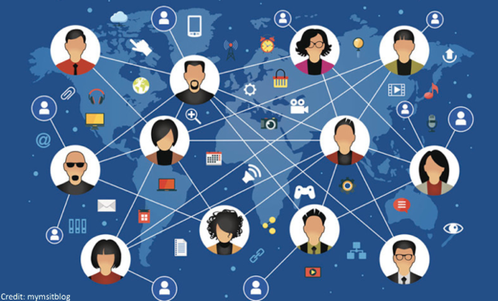
What’s the passage mainly about?
The passage is mainly about how people’s lives have been changed by online communities and social networks through Jan’s experience.
Notes:
Pair discussion
Where can we find the author’s opinion？
What about the rest of the passage? How does the author illustrate the opinion?

Slide 6
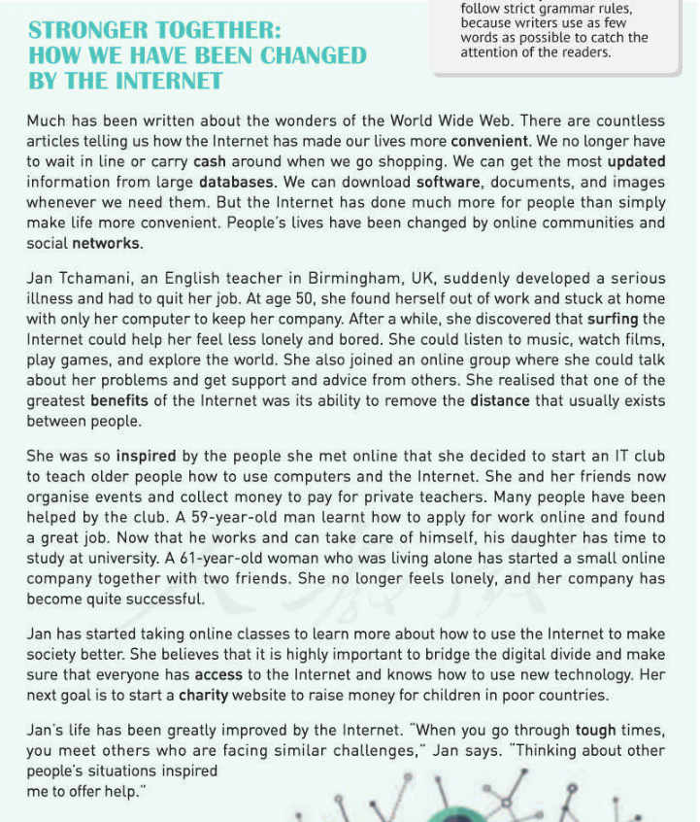
Opinion
Feature story
(专题报道)
Example
Notes:
Pair discussion
Where can we find the author’s opinion？
What about the rest of the passage? How does the author illustrate the opinion?

Slide 7
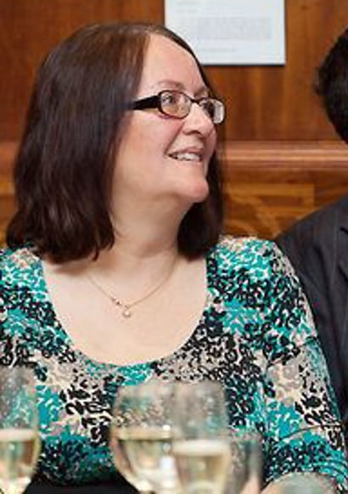
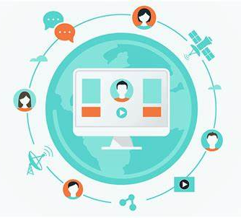
How has Jan’s life been CHANGED by online communities?
Before
After
how
what
what
how
developed a
serious illness
quit her job
stuck at home
lonely
boring
miserable
Notes:
At the beginning, how was Jan’s life? Did she join an online community at that time? (So that’s before...)
Then how has Jan’s life been after she went online? Did she help other people? (Pair work)
Underline what Jan did in the text and analyze how her life was.

Slide 8
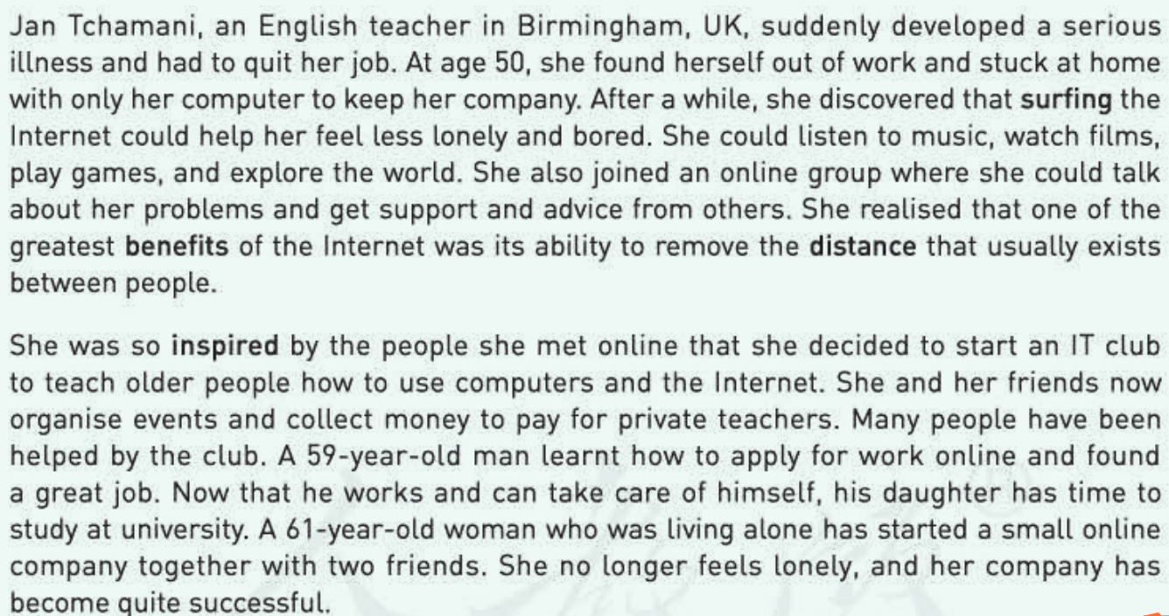

Slide 9
Notes:
一组学生report完后，可提问其他学生补充信息；追问出被帮助的人生活如何，以及digital divide

Slide 10
Digital divide refers to the gap between those able to benefit from the Internet and those who are not.--Wikipedia

Slide 11
How does Jan’s experience show “Stronger together”?
Jan led a more fulfilling life and got support from the online community. Then she was inspired to offer help to a larger group of older people and was determined to make the society better by bridging the digital divide. Her life has been greatly improved. Not only Jan but also the people she helped have become stronger. It is the Internet that connects different people together to form an online community, which makes people stronger together.
Notes:
Group discussion

Slide 12
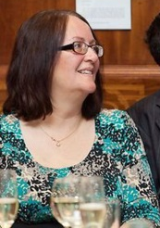
“When you go through tough times, you meet others who are facing similar challenges. Thinking about other people’s situations inspired me to offer help.”
There have been many “Jans” around us on the Internet.
Who are they?
What did they do?
Got stuck at home;
Felt panic, lonely, bored;
Needed help…
Notes:
选一、两个人简单讲；take notes on P29 Ex.3 while watching

Slide 13
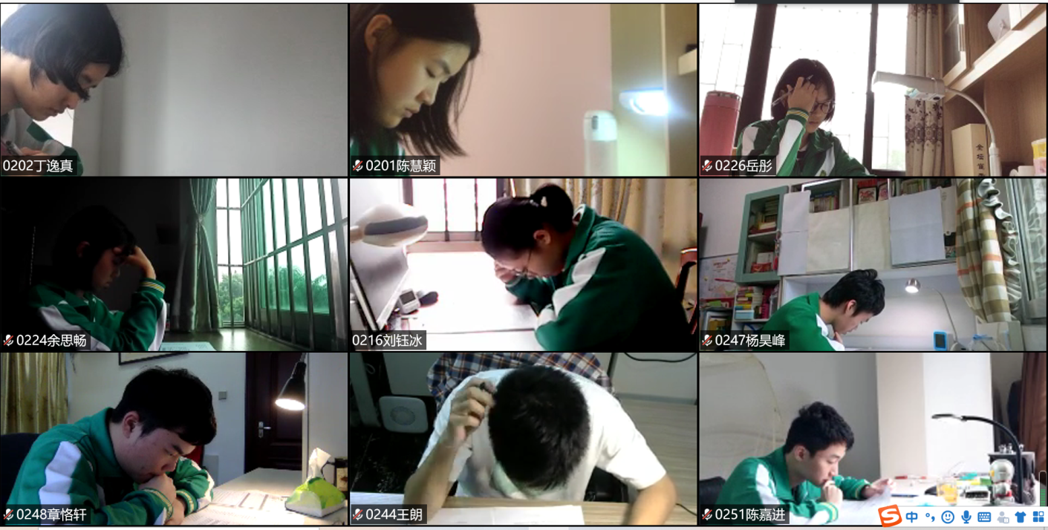
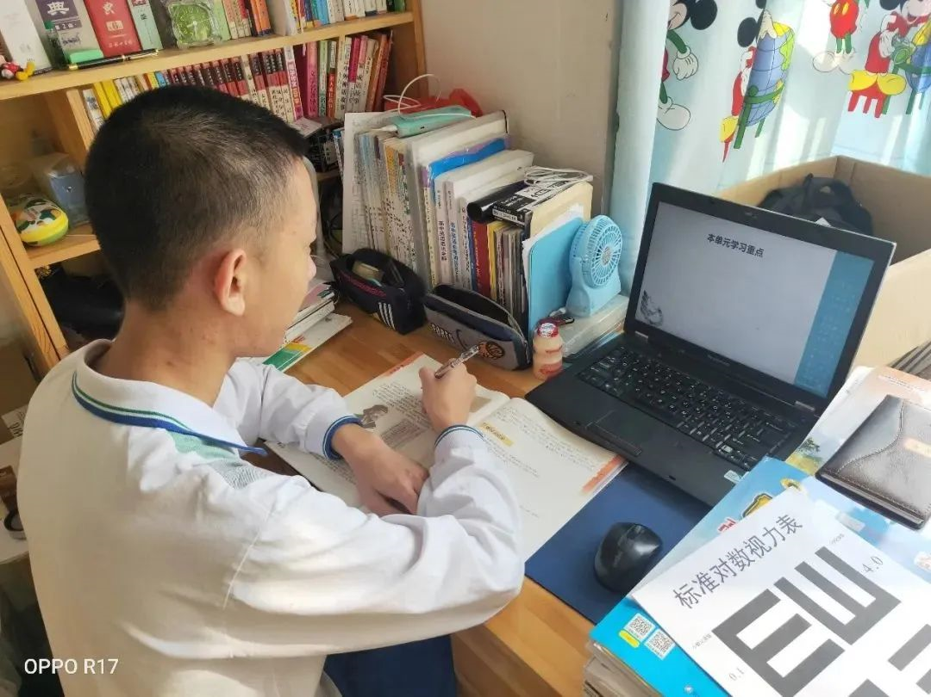
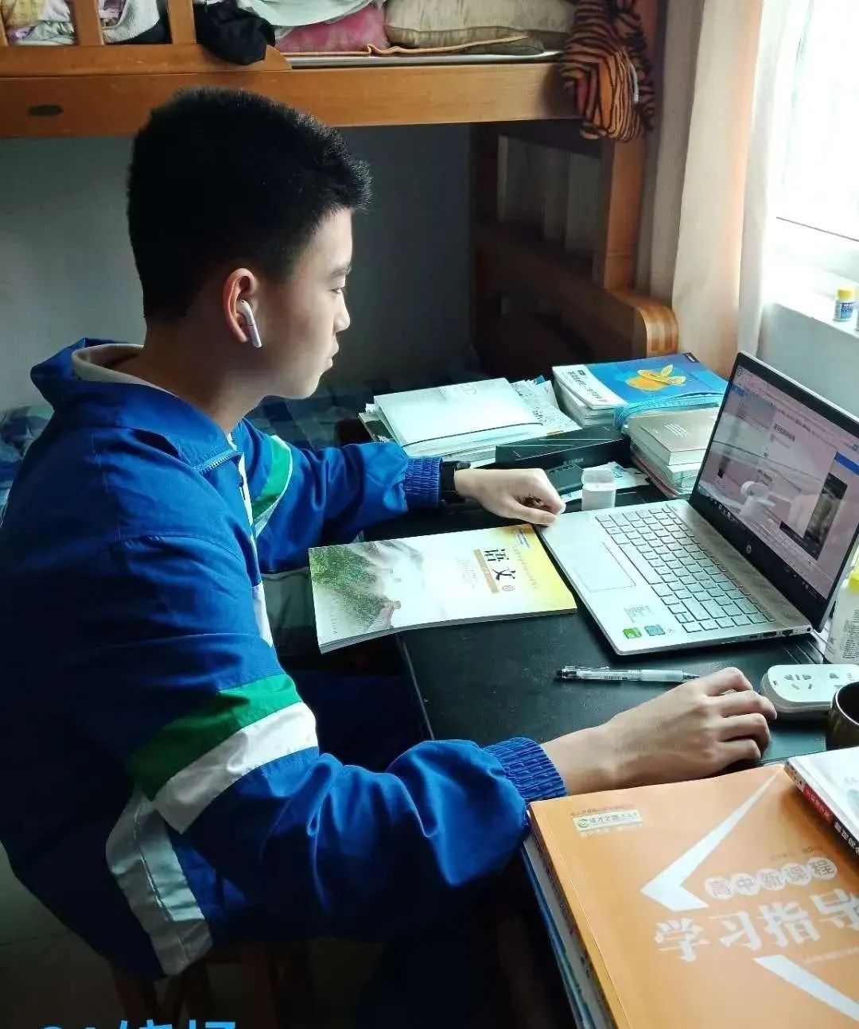
Teachers

Slide 14
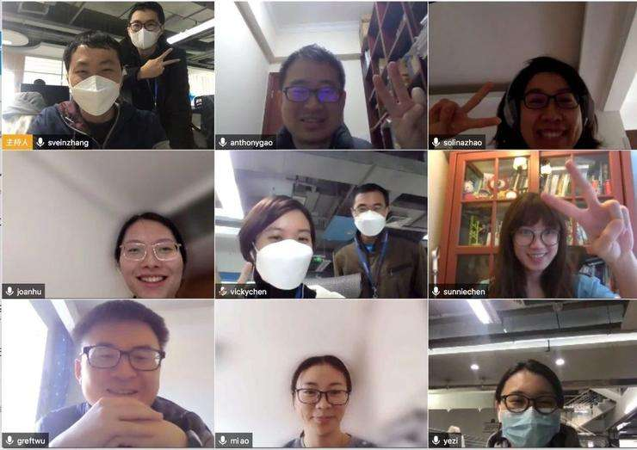
Friends

Slide 15
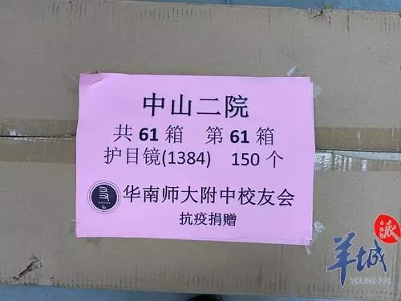
The school alumni association (校友会)

Slide 16
Doctors

Slide 17
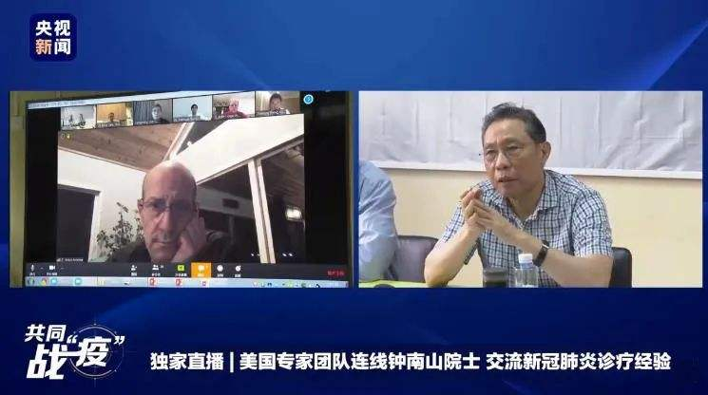
Experts

Slide 18
Singers

Slide 19
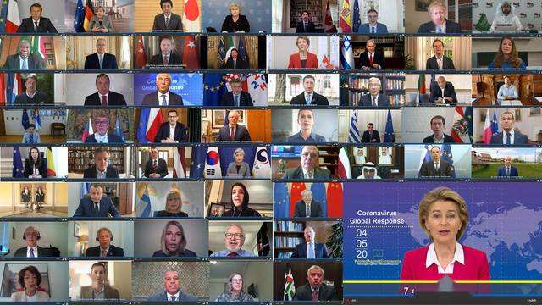
Government Leaders

Slide 20
more examples
Teachers provided online lessons to help us with learning.
Friends chatted in online chat rooms to support each other.
The school alumni association raised money online to buy protective gowns (防护服).
Doctors provided online medical service to help patients.
Experts held online meetings to exchange experience and thoughts.
Singers took part in online concerts to call on everyone to stay at home.
Government leaders discussed on online meetings to help fight against the pandemic.

Slide 21
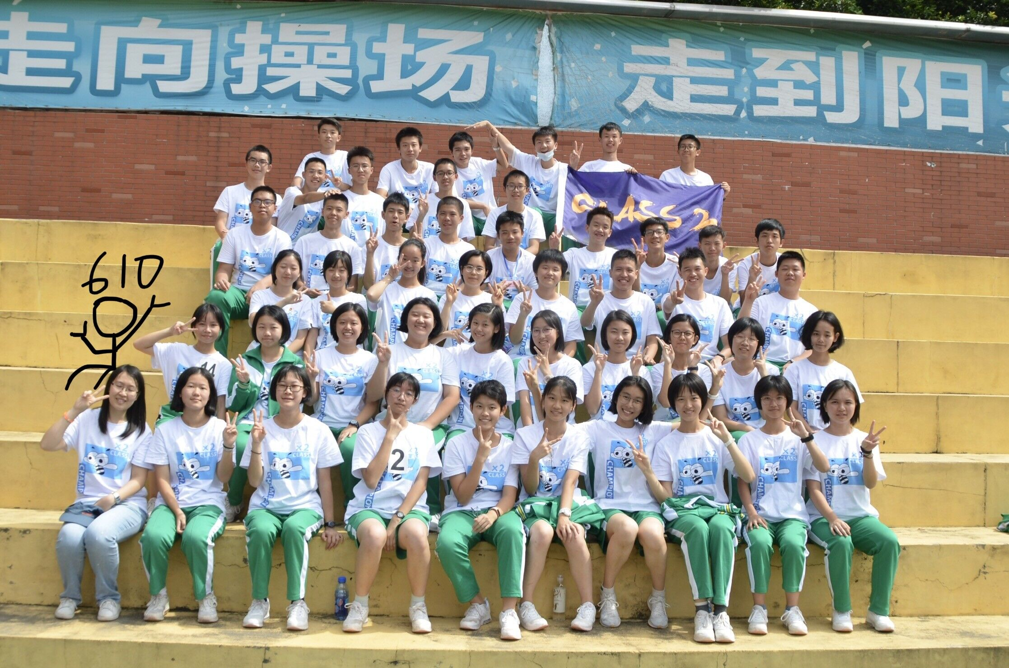
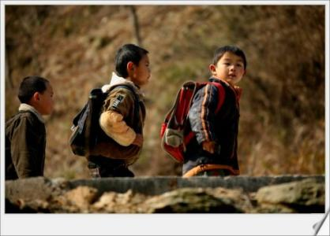
We can also be a “Jan”.
Who would you like to help?
What do they need?
How will you help them through the Internet?
How will their life be through your help?
teenagers
left-behind children

Slide 22
examples from the text
more examples
listened to music
watched films
played games
explored the world
joined an online group
started an IT club
applied for work online
started a small online company
took online classes
started a charity website
provided online lessons
chatted in online chat rooms
raised money online
provided online medical service
held online meetings
took part in online concerts
discussed on online meetings

Slide 23
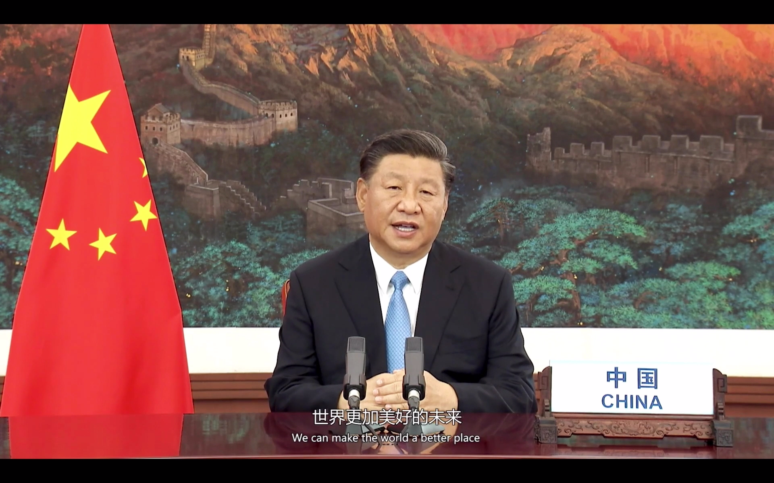
Together, we can make the world a better place!
Notes:
Post reading: 我们身边有很多Jan,用互联网的优势帮助着人；
疫情期间：online classes, 朋友通过网络互相陪伴，校友会网上筹款并联系国外筹集物资，一些歌手在网上开慈善音乐会传播正能量，农产品网络带货帮助出售滞销产品；医生进行远程诊病；
国家在做什么推动社会发展。

Slide 24
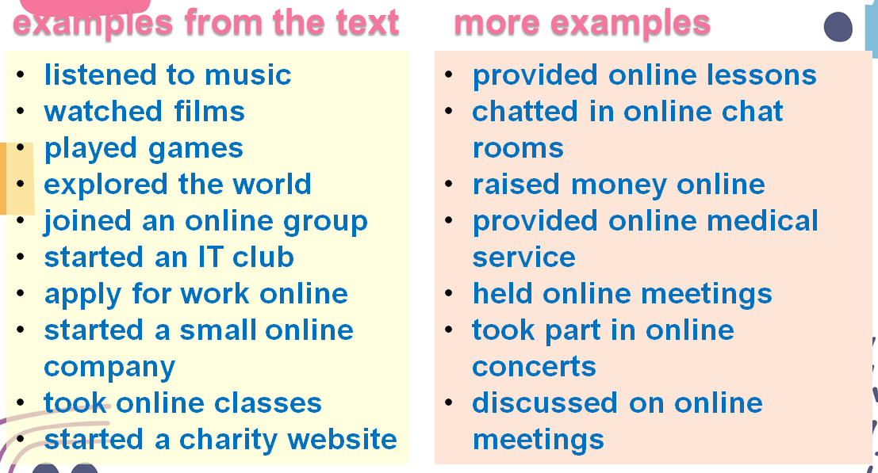
Homework
Work in groups to list the disadvantages of using the Internet, and brainstorm ways to overcome the disadvantages.
What can the government do?
What can the schools do?
What can we do?
…

