Slide 1
Continuation writing
based on text book（M7U2 satisfaction guaranteed）
基于教材内容的读后续写
广州市第六十五中学 林慧静

Slide 2
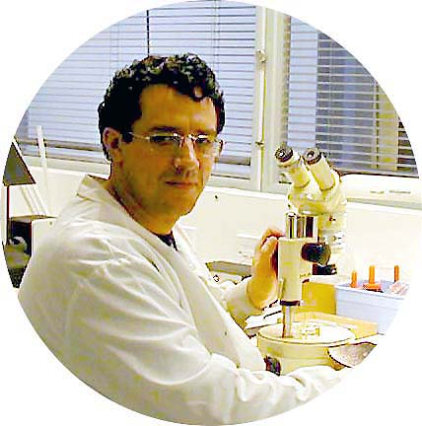
Main characters:
Tony helped Claire
in many ways.
Claire
Tony
(robot)
(housewife)
programmed and
controlled by Larry's
company
couple
(He wanted Tony to be _____ ____ by his wife in the house.
tested out
Larry
robots
work for a company that made _______

Slide 3
Pre-writing：

Slide 4
A writing task:请根据课文内容和所给段落开头续写两段，使之构成一篇完整的短文。续写词数150词左右。
key words:
Para.1 Claire was heart-broken after Tony left.________
_____________________________________________________
_____________________________________________________
Para.2 Two weeks later, Tony showed up at the front door. ___
_____________________________________________________
_____________________________________________________
What can be inferred(推断) about the plots development from these sentences?

Slide 5
Pre-writing :
1. Group discussion for plot development
(2 mins)
outline
(3 mins)
2.Make an outline(提纲) for your writing
Para.1 Claire was heart-broken after Tony left.
Para.2 Three weeks later, Tony showed up at the front door.
How
would
you
like
the
story develop?

Slide 6
1st Tip: ：
如何构建续写的情节？
Questions & Answers
What happened to sb?
What was the result?
key word
What did sb do?
What did sb learn from sth?
How did sb feel?

Slide 7
Para.1 Claire was heart-broken after Tony left.
Q1. Why was Claire heart-broken?
fall in love; mentally dependent
Q2. What were the details of Claire’s sadness?
(What did she do ?)
heart-broken
Q3.When Larry came back home, how did he react(反应) to his wife’s feeling?
cry; sob;weep; miss; think of; can't help doing;burst out crying ;burst into tears
sad; depressed; in low spirit
sadly;sadness/sorrow
surprised
comfort
promise

Slide 8
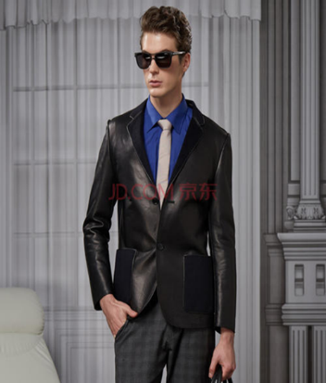
Para.2 Two weeks later, Tony showed up at the front door.
?
Q2. What did he say and do when Claire opened the door?
greet sb; introduce oneself
Q3. Seeing Tony again, what was Claire’s feeling and what did she do?
Q1. What were Tony's changes after being rebuilt?
Tony showed up
less handsome;
memories: removed
surprised; disappointed
try to remind Tony
Q4. What was the result?
What did Claire learn from this experience?
calm down;
realize:
not depend on a machine; independent

Slide 9
2nd Tip:
提纲
para.1的关注点：
细节描写
A possible outline:
Para.1 Claire was heart-broken after Tony left.
Para.2 Three weeks later, Tony showed up at the front door.
Claire: sad;
miss Tony
Larry came home
T&C met again
T's changes
C's reaction and feelings
C calmed down & her realization:
主题升华

Slide 10
3rd tip :
必杀技：
“to show, not to tell”
我们续写的时候，要避免概括性地讲述(to tell)，而要进行细节描写(to show)，即通过对角色的刻画，包括动作、外在表情、内在情感、心理活动的描写（这些可以说是续写的“血肉”），来使人物形象更加立体。

Slide 11
Revision:
How to describe a person's sadness?
1. sad; sadly; sadness/sorrow;
2.“cry”:
cry; sob;
can't help crying
burst out crying
burst into tears
in low spirits;
be depressed
heart-broken
3.Every time sb thought of ....., sth crowded into one's mind.
4.Her heart ached extremely, tears rolling down her cheeks.
5.She felt seized by a burst of sadness and couldn't help crying
bitterly.
6.Hearing ..........., so desperate was he that ......

Slide 12
While-writing：

Slide 13
While-writing：
Para.1 Claire was heart-broken after Tony left. ________________________
________________________________________________________________________________________________________________________________________________________________________________________________________________________________________________________________________________________________________________________________________________________________________________________________________________________________________________________________________________________________________________________
Para.2 Two weeks later, Tony showed up at the front door. ______________
________________________________________________________________________________________________________________________________________________________________________________________________________________________________________________________________________________________________________________________________________________________________________________________________________________________________________________________________________________________________________________________
细节描写
Let's try!
within 15 minutes !
主题升华

Slide 14
Post-writing：
1.Present an assessment form of continuation writing.
2.Evaluate some students' writing and focus on some expressions about description, including some adjectives and verbs.

Slide 15
An assessment form for your writing:
Assessment for your writing (评价表) | （0-5 分）
1. Well consistent with the text and core socialist values (主题上，是否与课文一致；是否符合社会主义核心价值观)
2. Well connected with the text and the two given sentences？(连贯上：是否与课文衔接?；是否与续写的两段首句衔接?)
3. Reasonable and logical？ (情节上：是否合理和有逻辑？)
4.Rich and vivid？ (语言上：是否丰富和生动？是否有情感的细化，包括动作描写和心理活动等等的描写)
5.主题是否有升华？
Total scores

Slide 16
Post-writing：
Share your writing!

Slide 17
Summary:
Tips for continuation writing:
1st tip:Creating plots of a story :Questions & Answers
2nd tip: Making an outline: plots line&emotion line
3rd tip: Describing a person's feelings in details:“To show, not to tell”

Slide 18
2.19 读后续写 A Little Boy（教学课件）-高考英语作文新题型【精美版】
Homework
1.Finish and polish your writing.
2.Under the expressions about describing a person's feelings in your writing.
3.Assess your own writing and your teammates’ writing
2.19 读后续写 A Little Boy（教学课件）-高考英语作文新题型【精美版】

Slide 19
Thank you for your listening!

Slide 20
A sample writing

Slide 21
细节描写
One possible version:
Claire was heart-broken after Tony left. Most of the time, Claire locked herself in her room, crying into her pillow. So much did she miss him that she couldn’t stop thinking about the happiness Tony had brought to her. “How can I live without Tony? ”, she sobbed her heart out.
The next day, Larry came back and was surprised at Claire’s changes as well as their home’s at first, but realized it was Tony’s work. He asked Claire if she was satisfied with Tony. With a sense of embarrassment, Claire replied, “He is good…Will he come back?” “Yes.”, Larry tried to comfort her and promised to get Tony back after he was rebuilt, knowing well the source of her wife's suffering.

Slide 22
Two weeks later, Tony showed up at the front door. “Hi, Madam, I am Tony, your household robot. ” said Tony when Claire opened the door. At first, Claire didn’t recognize Tony because he looked less handsome. But it was his familiar voice that convinced her that he was back , asking, “Tony, it’s me, Claire, don’t you remember me?” No matter how hard Claire tried to remind Tony of what had happened between them, Tony still couldn’t recall anything because all his memories had been removed. Disappointed, Claire rushed to her room, trying to calm herself down and reminding herself that Tony was just a machine and never should they fall in love. More importantly, one should be self-confident and mentally independent in the world.
主题升华

Slide 23
以下是部分学生的作文

Slide 24
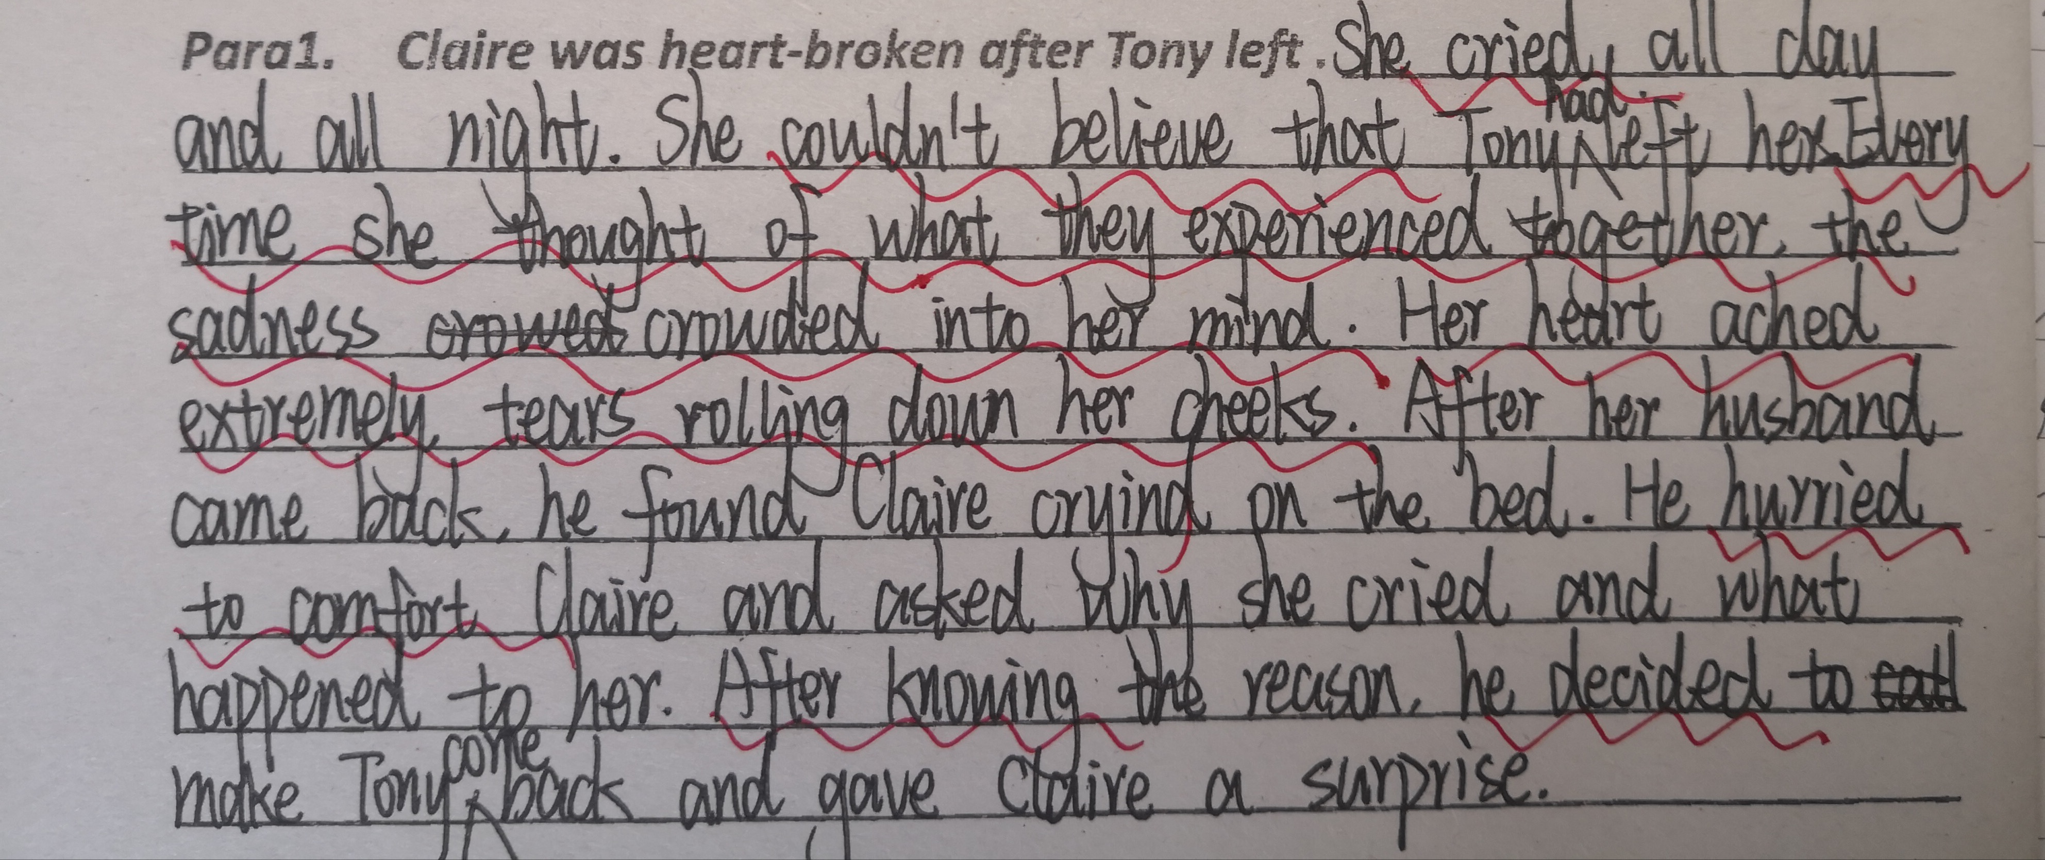
老师点评：心理描写和动作描写的用词丰富而生动

Slide 25
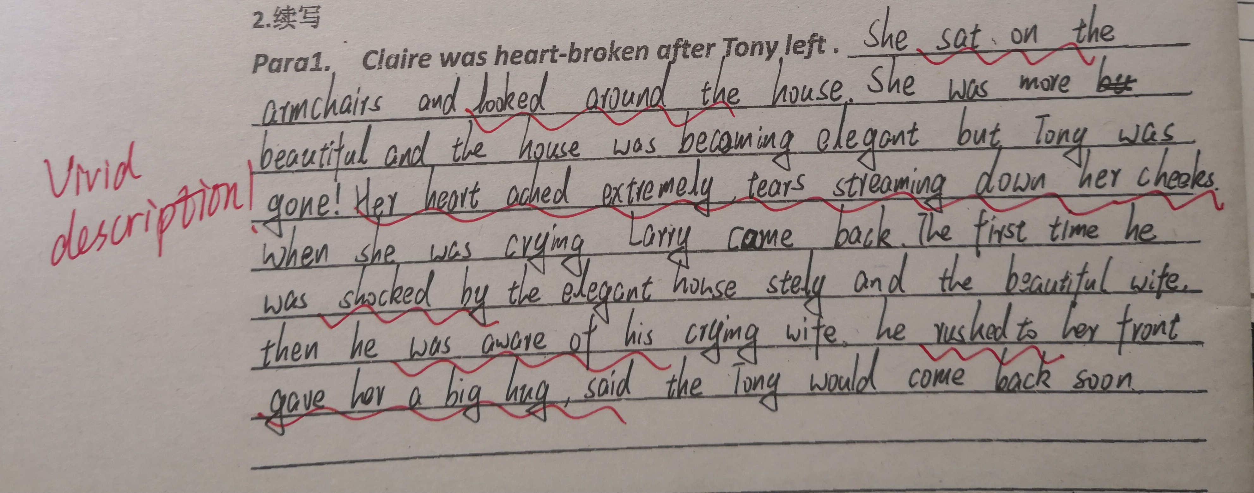
老师点评：关于细节描写的微技能掌握得很好！

Slide 26
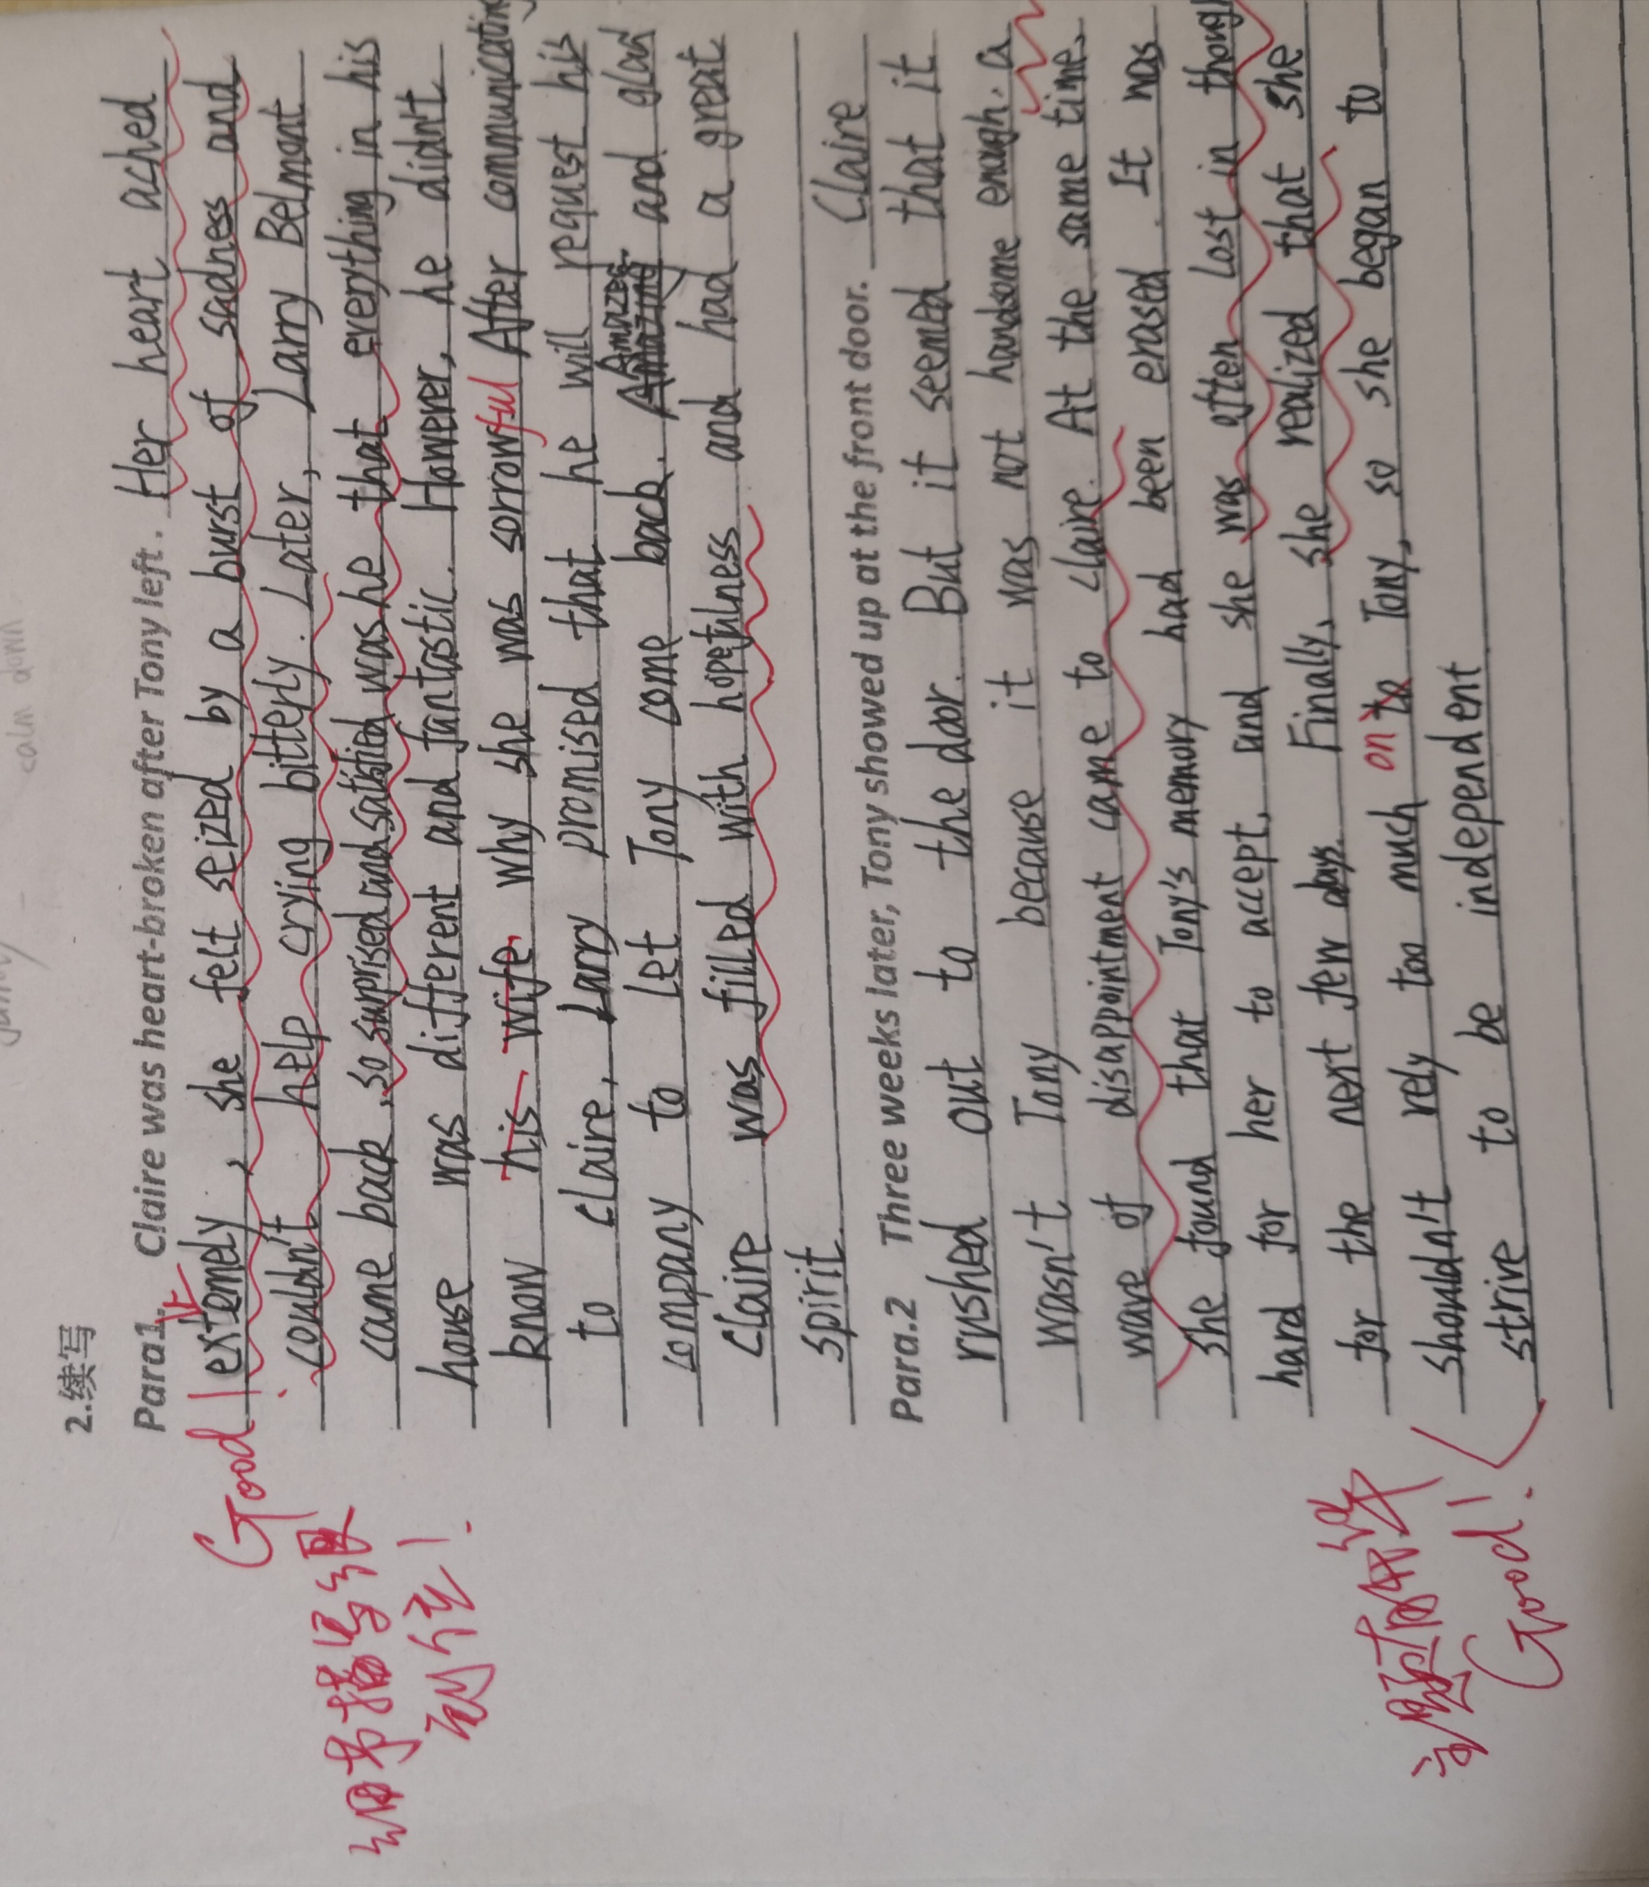

Slide 27
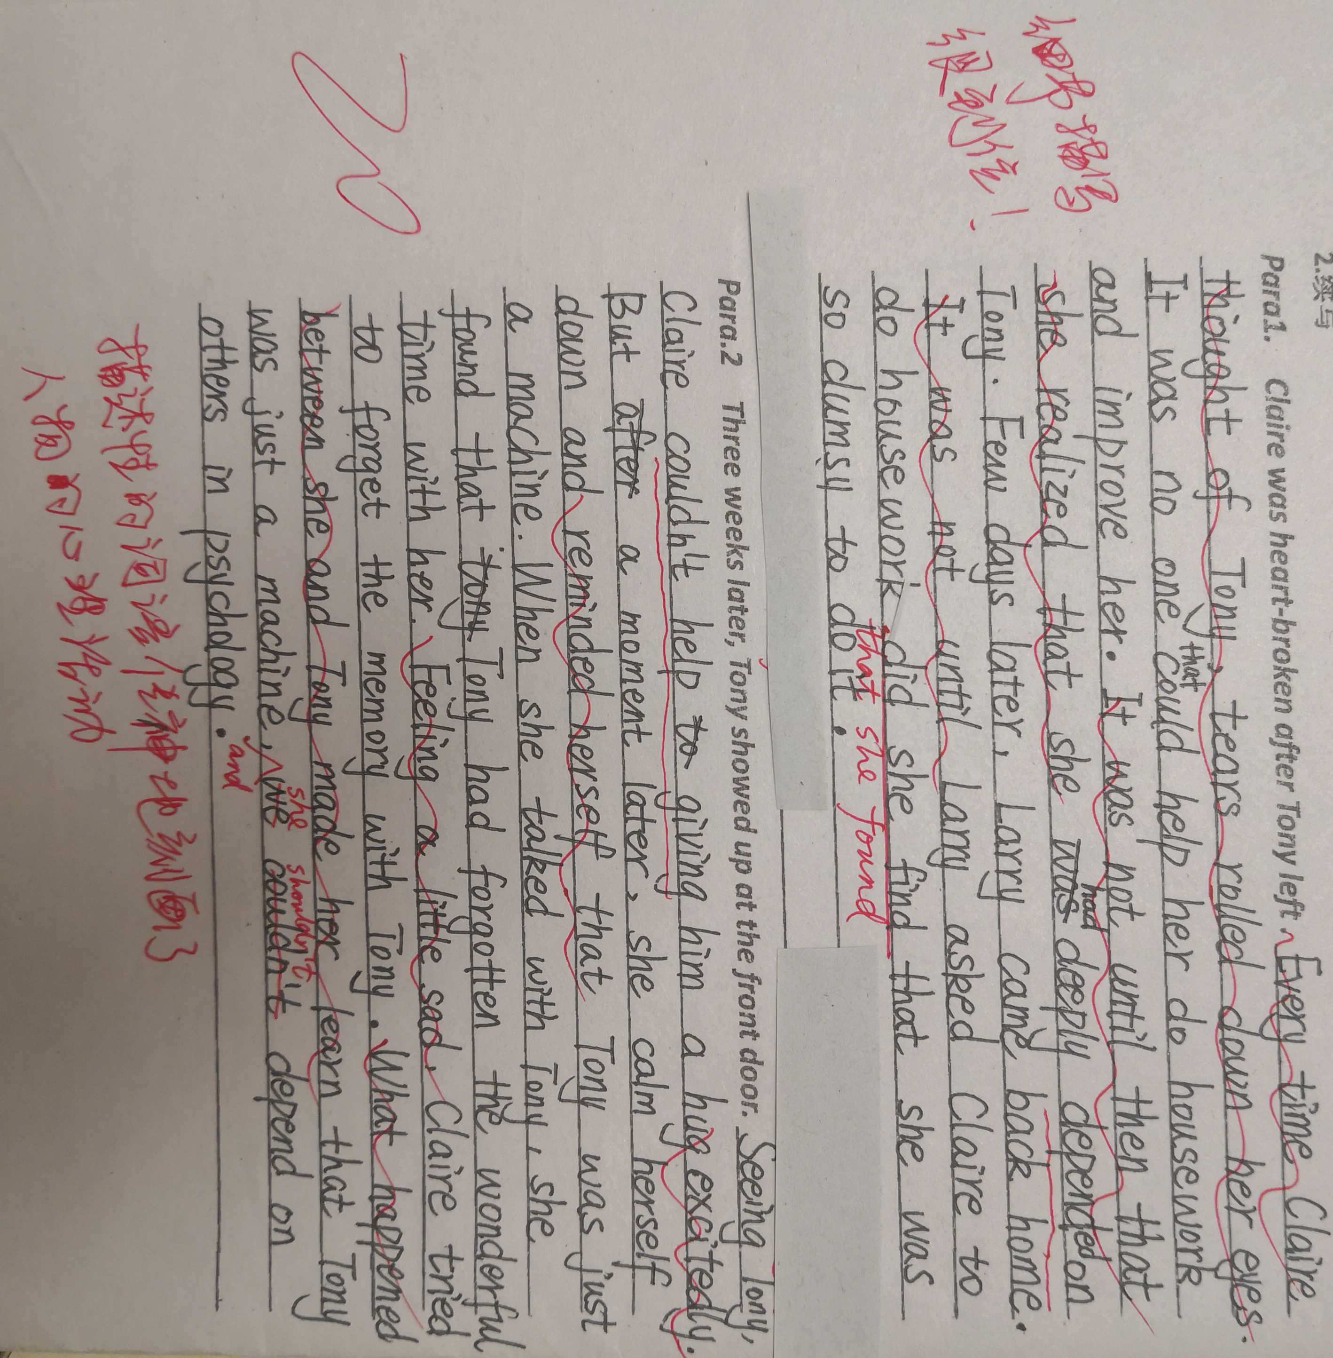
学生的作文

