Slide 1
M7U5 Traveling Abroad KEEP IT UP, XIE LEI
Language focus

Slide 2
教学内容
本课时为单元第2课时，为2003人教版M7U5阅读篇章KEEP IT UP, XIE LEI语言点教学。
教学目标
培养学生在语篇中快速定位目标语言的能力；
培养学生观察真实语料、自觉总结语言规律的能力，培养学习者的思考、推理能力；
培养学生"说"的能力以及使用恰当语言的语用意识。

Slide 3
教学方法、模式、策略
可视化信息输入、观察归纳、小组合作讨论
教学媒体
Antcon语料库检索工具，电子辞典

Slide 4
教学过程展示
复习语篇→语言学习→综合运用

Slide 5
Revision
What is this passage most possibly from?
Keep it up, XIE LEI Chinese student fitting in well
Title
Subtitle
continued on page 39
continued from page 38

Slide 6
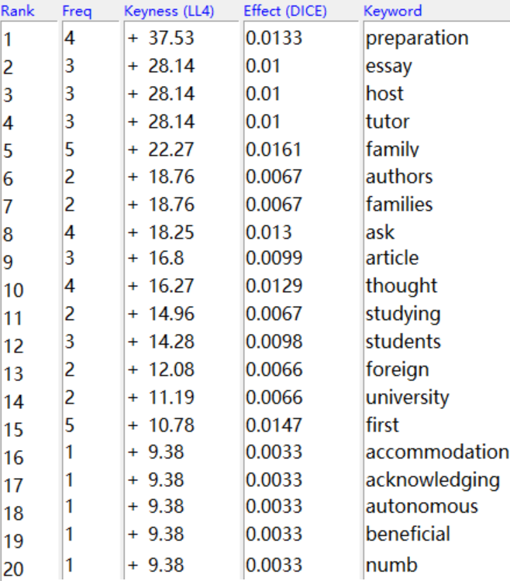
Revision
What aspects are mentioned?

Slide 7
Revision
In what order is this passage organized?
host*|famil*|life*
tutor*|essay*|author*|article*|thought*|lesson*

Slide 8
Revision
Please retell the main idea of the passage according to the key words and their location.

Slide 9
Language use - word
board
lecture
acknowledge
contradict
substitute

Slide 10
Language use - phrase
get used to/adjust to/adapt to
keep it up/keep up/keep up with
fit in (with)
as far as one is concerned

Slide 11
Language use - sentence
It is/was the first time (that)…/…for the first time/The first time…

Slide 12
Language use - collocation
numb with */numbed*

Slide 13
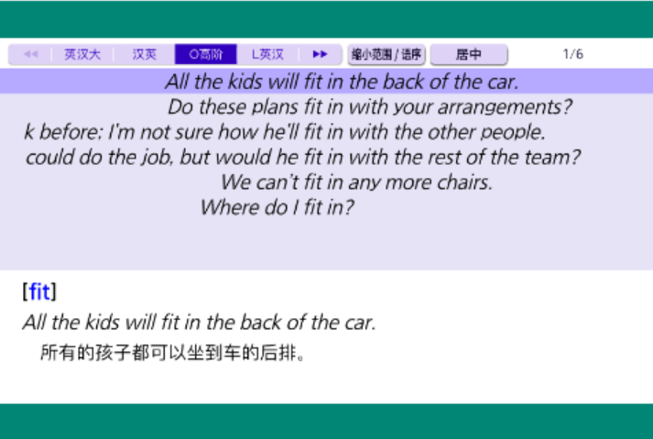

Slide 15
Language practice
Suppose you are a newspaper reporter. Please interview Xie Lei /Xie Lei’s host family/Xie Lei’s tutor using:
board, lecture, acknowledge, contradict, substitute, get used to/adjust to/adapt to, keep it up/keep up/keep up with, fit in (with), as far as one is concerned, It is/was the first time that…/…for the first time/The first time…, numb with */numbed*, etc.

Slide 17
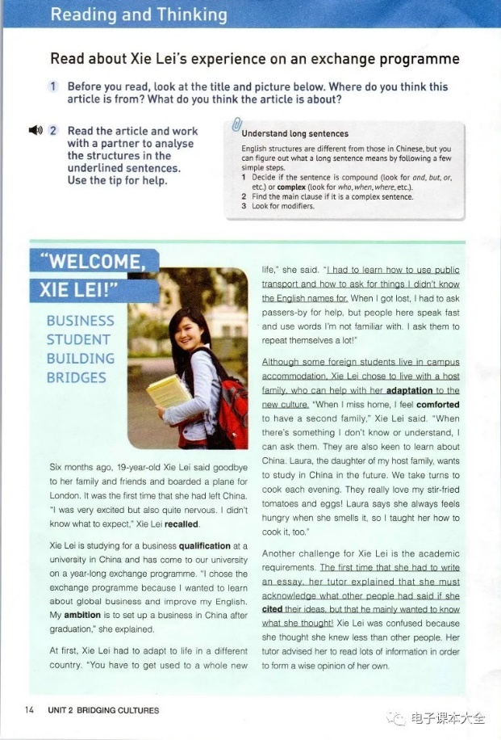
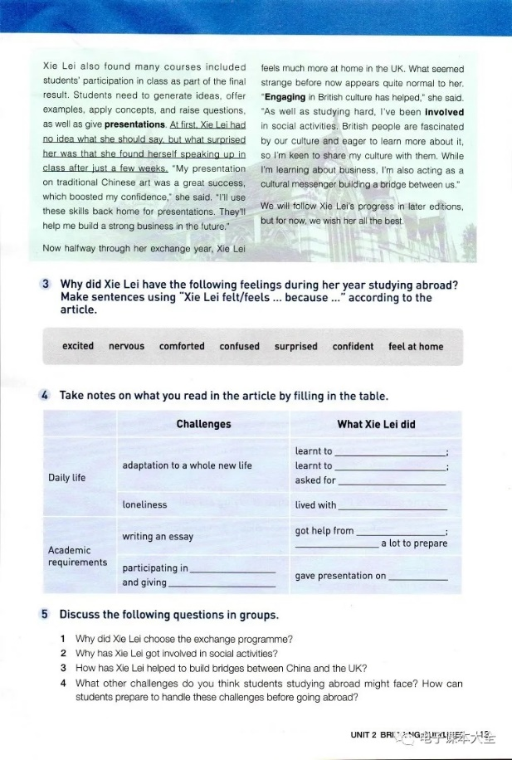
作业
对比新旧教材文本，感受结构/用词不同

Slide 18
本课亮点
可视化信息输入、电子辞典资源呈现、观察归纳、小组合作讨论
理论依据
《高中英语课程标准》（2017年版2020年修订）
数据驱动学习(DDL)：“教师在语境中呈现新的语言知识，指导学生观察其使用场合、表达形式、基本意义和语用功能，总结、概括具体语言形式的结构、意义和使用规律。”
电子词典：“教师应该发挥现代教育技术对教与学的支持和服务功能，指导学生合理利用电子词典等工具开展学习。”

